Slide 1

www.elsa-support.co.uk

Slide 2

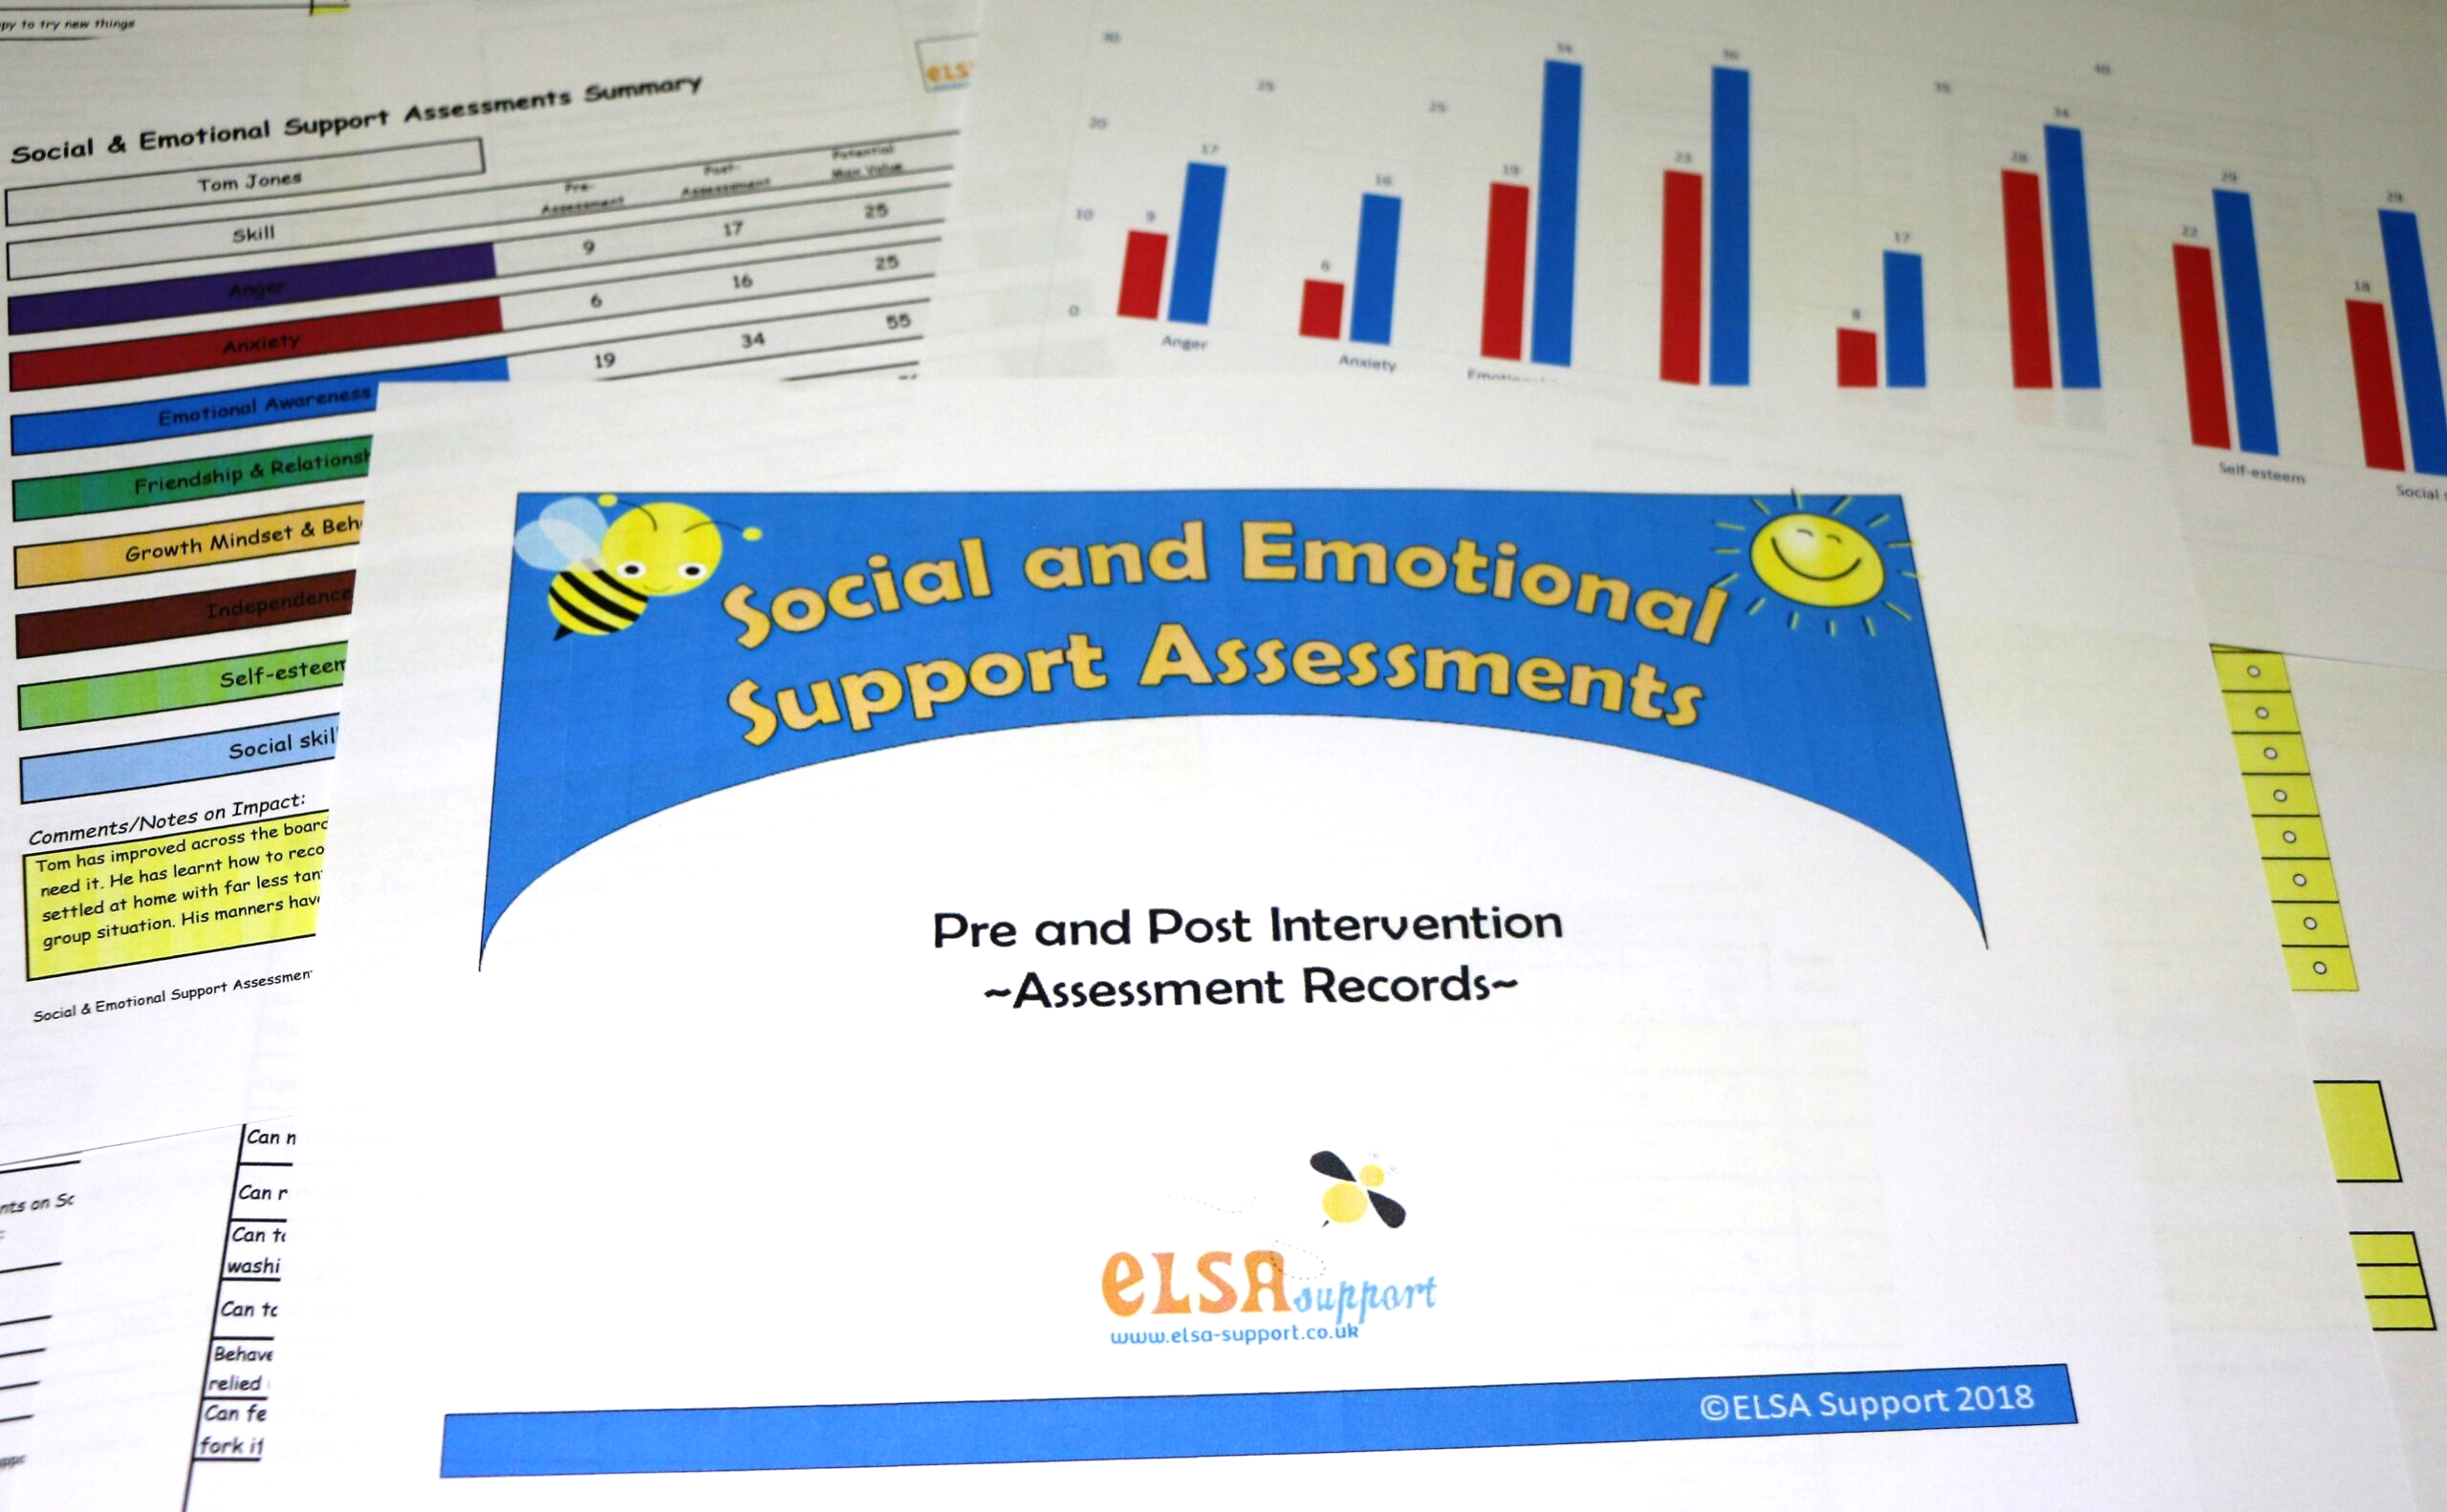
www.elsa-support.co.uk

Slide 3
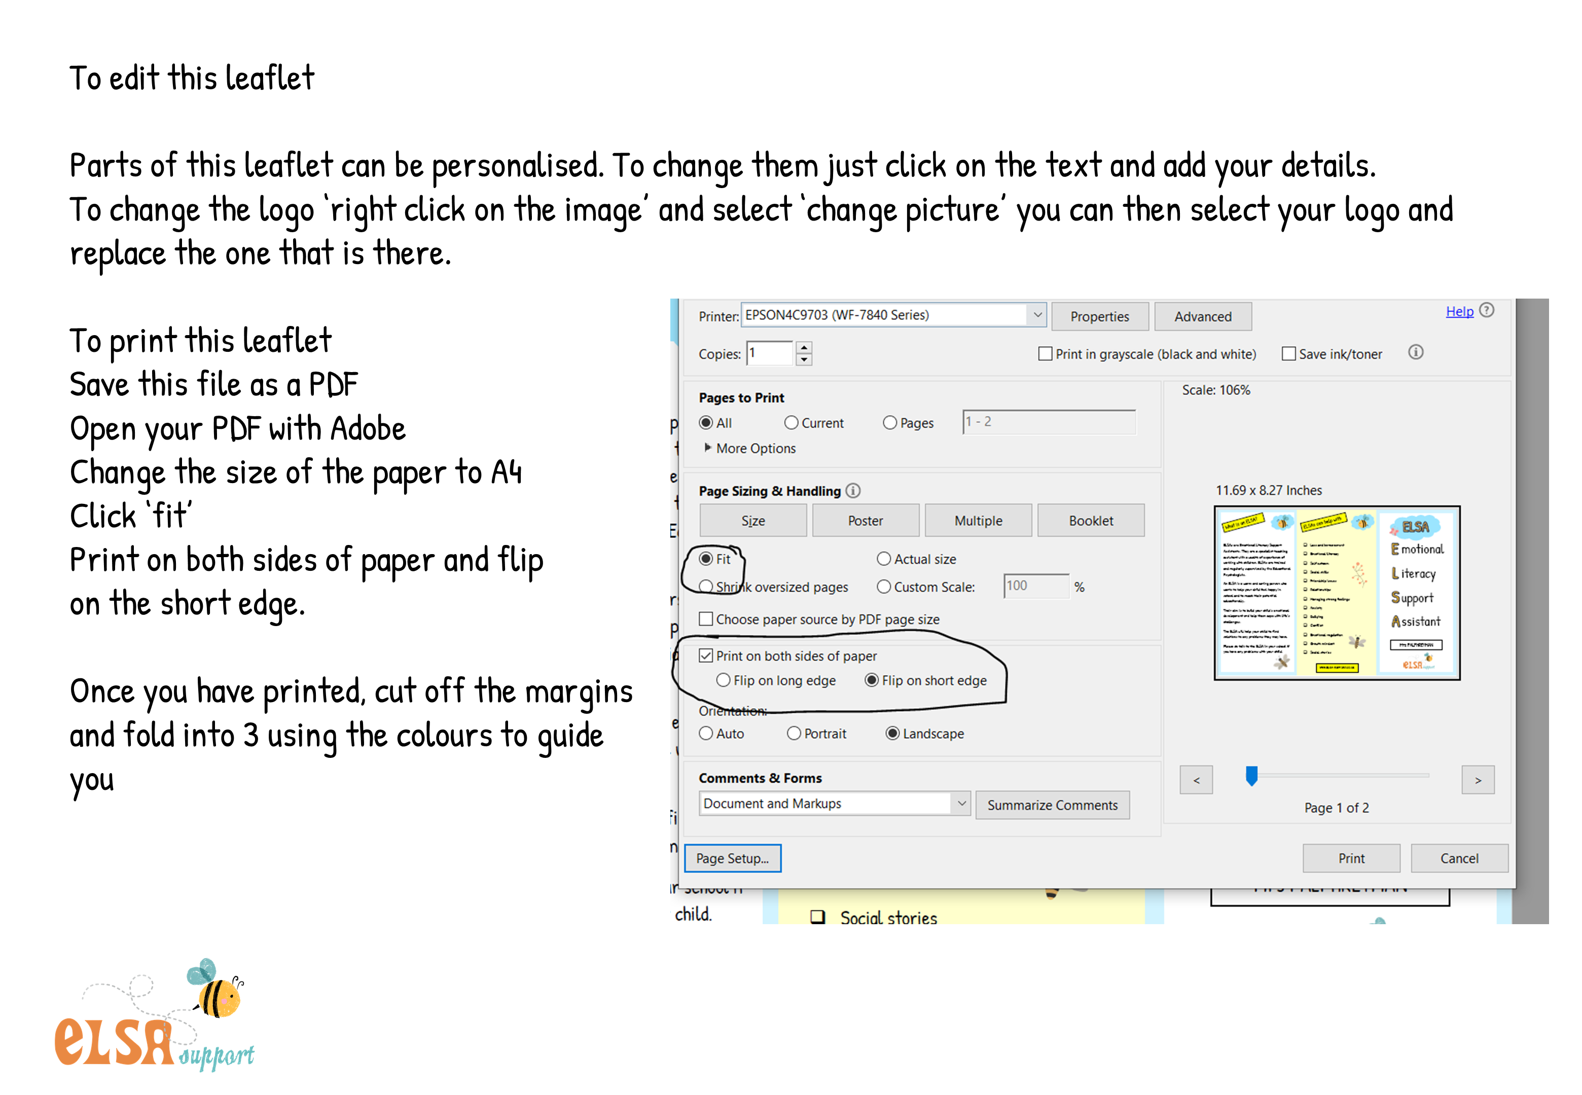

Slide 4


Mrs Sarah Bowley (SENDCo)
Tel. 01525 237253
Email: sbowley@stleonardslower.co.uk
St Leonard’s Lower School
Thrift Road
Heath and Reach
LU7 0AX
www.stleonards.beds.sch.uk
Mrs Joanne Newens

Slide 5


