Slide 1
St Leonard’s VA Lower School

Slide 2
Reminder…

Slide 3
Sound Pronunciation
It is important that we use pure sounds, such as ‘s’ not ‘suh’, so that your child will be able to blend the sounds into words
https://www.oxfordowl.co.uk/for-home/reading-owl/find-a-book/read-write-inc-phonics--1/phonics-pure-sounds-video

Slide 4










Systematic Approach
sat
p
mat
d
sad
i
t
n

Slide 5
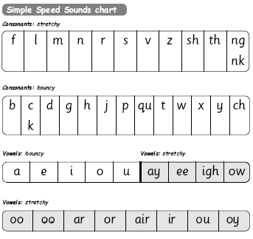
Simple Speed Sounds

Slide 6
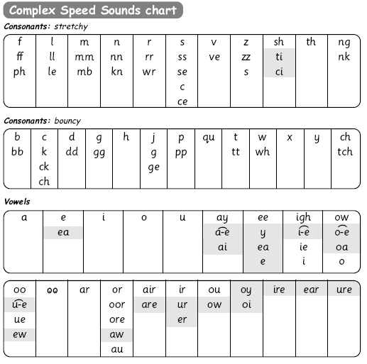
Speed Sounds Chart
Notes:
We use this Speed Sounds chart in Phonics lessons.
It shows the most common graphemes for each sound.
Each box is a sound box showing different ways to read and write the sound. Demo the ‘f’ sound box with examples of words ‘fun’, ‘huff’, ‘photo’ and the ‘or’ sound box with examples of words ‘or’, ‘door’, ‘more’, ‘dawn’, ‘author’.

Slide 7
Blending Using Fred Talk, Including Fred Talk Games
p
d
sat
i
t
mat
sad
n

Slide 8

Fred Talk

Slide 9




Storybooks

Slide 10

What should my child read at home?

Slide 11



Picture Books And Anything That Interests Them!

Slide 12
How does Read Write Inc. teach spelling?

Slide 13

Fred Fingers

Slide 14
How can I help at home?

Slide 15
Storytime
Read to your children
Ask lots of questions and share opinions
Use a RWI support pack
You're never too old, too wacky, too wild, to pick up a book and read to a child.
Dr Seuss

Slide 16
Support How Your Child Is Learning To Read And Spell In School
Pure sounds
Fred Talk
Fred Fingers
Lots of talking!

Slide 17
Online resources available
Ruth Miskin Parents’ Page:
https://www.ruthmiskin.com/en/find-out-more/parents/
https://home.oxfordowl.co.uk/reading/reading-schemes-oxford-levels/read-write-inc-phonics-guide/
Free e-books for home reading:
https://home.oxfordowl.co.uk/reading/

Slide 18
Useful websites
Online resources and games...
Oxford Owl: www.oxfordowl.co.uk
Phonics Play: www.phonicsplay.co.uk
Letters & Sounds: www.letters-and-sounds.com
Articulation film clip: http://www.teachfind.com/national-strategies/teaching-activities-related-articulation-phonemes-vowels-and-consonants
Teach Find: www.teachfind.com
Scotts MLE Reception page:
BBC: www.cbeebies.co.uk
Free resources to support learning...
www.twinkl.co.uk
www.letters-and-sounds.com

Slide 19

Thank you for coming

