Slide 1
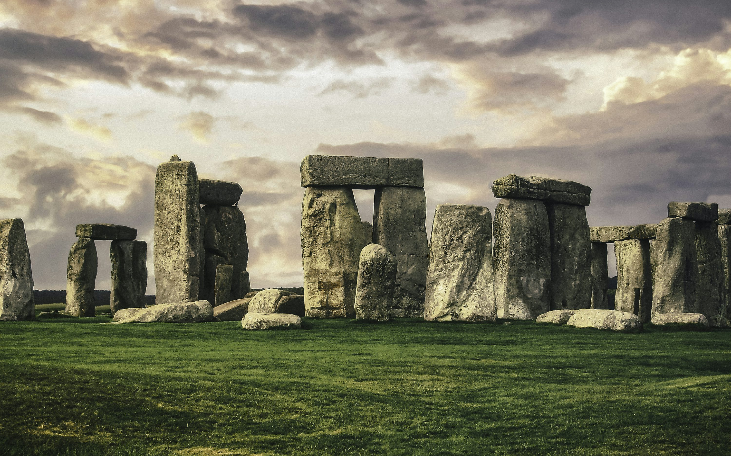
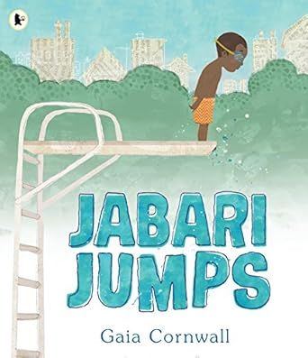
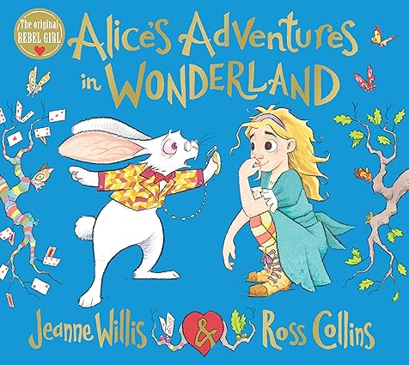

English
Narrative – Setting and dialogue. Alice in Wonderland
Personal Narrative – Jabari jumps
Persuasive speeches – Stella & the seagull
Poetry: Calligrams – Love that Dog
Maths
3x 4x and 8x multiplication and division facts
Fractions – Denominators and numerators. Whole and equivalence
Statistics – Collecting and recording data. Bar charts
Money – Convert pounds and pence. Give change
History – Stone, Bronze and Iron Age
Would you prefer to have lived in the Stone, Bronze or Iron Age?
How long ago did prehistoric man live?
What does Skara Brae tell us about the Stone age?
The impact of Bronze Age Britain.
Trade in the Iron Age
What changed between the Stone Age & the Iron Age?
PSHE
Dreams & Goals
Safer Internet Day
Healthy Me
Science
Light & Shadow
Plant Reproduction
RE
Islam – How do festivals & worship show what matters to Muslims?
Christianity – How and why do people try to make the world a better place?
Geography – Rainforests
Why are the Rainforests important to us?
Where are tropical rainforests?
The Amazon
Who lives in the Rainforest?
How are rainforests changing?
Art / DT
Drawing – Developing Drawing Skills
Structures - Castles
Computing
Programming – Sequencing sounds
Branching Databases
PE
Swimming & Dance
Swimming & Yoga
French
Playground Games
Numbers and Age
Music
Music & Video
You Gotta Try!

