Slide 1


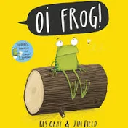

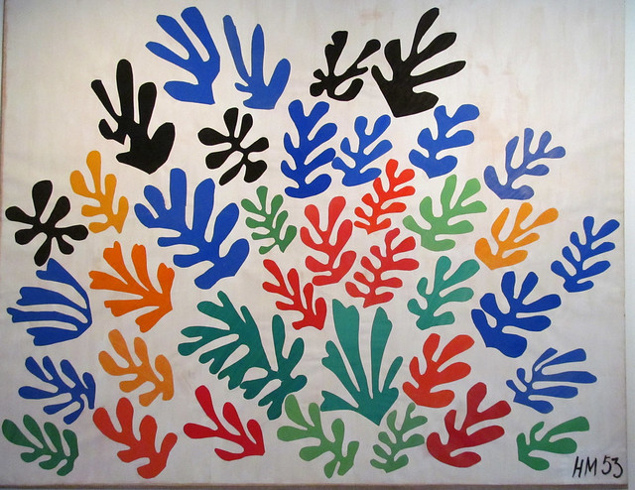
Science
Animals – Sensitive Bodies
Naming/labelling parts of the body.
What are our senses and what does each one do?
Recording data.
Animals – Comparing Animals
Animal groups.
Describing & comparing animals.
Carnivore, herbivore, omnivore.
Pets.
Key Texts
English
Narrative – Stanley’s Stick
Recount – Ravi’s Roar & Ruby’s Worry
Poetry – Oi Frog!
Narrative – Madlenka
Poetry – Poems to Perform
Mathematics
Addition & subtraction within 20.
Place Value within 50.
Measurement – Length & Height.
Measurement – Weight & Volume.
Geography
What is the weather like in the UK?
Where is the UK?
What are the four seasons?
What are compass directions?
How do people prepare for different weather?
Phonics & Reading
Continue with the RWI phonics pragramme.
Reading comprehension
Art/Design & Technology
Painting and Mixed Media
Textiles – puppet making
Computing
Data & Information – Grouping Data.
Programming – Moving a Beebot.
History
How have toys changed?
What were toys like in the past – similarities and differences.
How have teddy bears changed over time?
Toy Making experience in school.
Music
In The Groove
Round and Round
RE
Creation – who made the world?
Salvation – Why does Eater matter to Christians?
PSHE
Dreams and Goals
Healthy Me
Physical Education Fitness, Ball Skills – football, Outdoor Adventure, Social Dodgeball.

