Slide 1
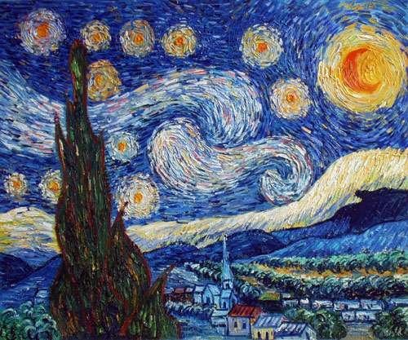
Science
Everyday materials – Comparing and grouping materials based on their properties.
Seasonal Changes – Observe changes across the four seasons and describe the associated weather and how the day length varies.
English
Labels, Lists and Captions
Narratives – Puffin Peter and Traditional Tales.
Poetry – List Poems.
Recipes – Gruffalo Crumble
Maths
Place Value – counting to 50, representing numbers to 50. Knowing 1 more/less, 10 more/less.
Addition and Subtraction.
PE
Yoga and Ball Skills
Gymnastics and Dance
Phonics
Continuing with the Read Write Inc programme – progressing on to Set 2 and |Set 3 Sounds.
Music
Hey You! Hip Hop
Banana Rap! Rhythm
Art/Design and Technology
Stable Structures – Exploring the stability of structures and making a stable pencil pot.
Drawing – Making Your Mark. Exploring how to create shapes and textures using different media.
Geography
What is it like to live here? Looking at aerial views of our local area.
Creating a map or our classroom.
Identifying different areas in our school and playground.
Making suggestions to improve our playground.
Year One
Autumn Term
Computing
Technology Around Us
Digital Painting
RE
What do Christians believe God is like?
Why does Christmas matter to Christians?
Harvest & Christmas.
History
How am I making history? Observing that some things chance and some things stay the same.
PSHE
Being Me In My World
Celebrating Difference

