Slide 1

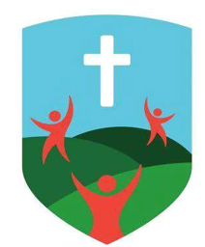
Internet Safety Presentation February 2025

Slide 2
The world we live in is rapidly changing. How do we keep up?
Did you know?
https://youtu.be/u_7G8Xy61zs?si=jQNEwFXU8D5J8ssD

Slide 3


TALKING TO YOUR CHILD ABOUT LIFE ONLINE

Slide 4


What are you most WORRIED about when your child is ONLINE?
Notes:
ASK: Find out what parents are currently worried about
TELL: Despite the positive finding that over seven in ten (72%) 8-17-year-olds who use messaging/social media sites or apps feel safe when using these apps/online sites, either all or most of the time, the online space is a risky environment for children.

Slide 5
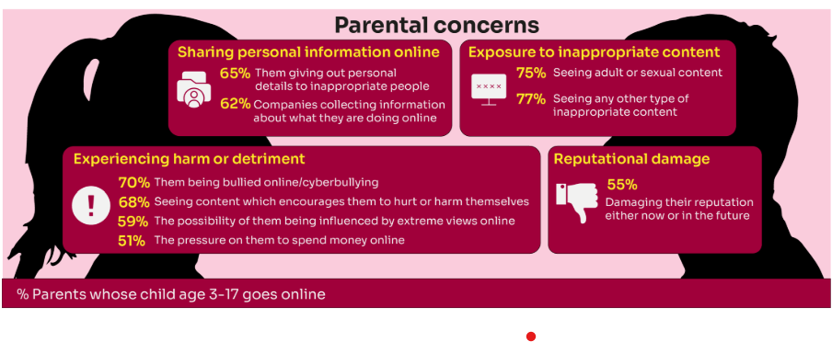
Summary of parental concerns (3 – 17 yr-olds)
Source: Children and parents: media use and attitudes report 2024
Notes:
Many parents indicate that they have concerns around various aspects of their children’s online activities.
The primary concern among parents of 3-17s is that their child will be exposed to inappropriate content for their age group (77% of parents were either very or fairly concerned about this aspect of their child’s online use) or see adult/sexual content (75% of parents).
Another common concern among these parents is that their child will experience some sort of harm or detriment while online; for example, seven in ten parents are concerned that their child will be bullied online (70%) or will see content which encourages them to hurt or harm themselves (68%).
Three in five (59%) parents are concerned that there is a possibility of their child being influenced by extreme views online.
Half (51%) worry about the pressure on their child to spend money online.
More than three in five parents are also concerned about their children giving away their personal data. Sixty-five percent are worried about the personal details the child themself may give out to inappropriate people, as well as 62% of parents who worry about companies collecting information about what their child is doing online.
Finally, over half (55%) of parents said they were concerned about their child’s online use and how it might damage their reputation, either now or in the future.

Slide 6
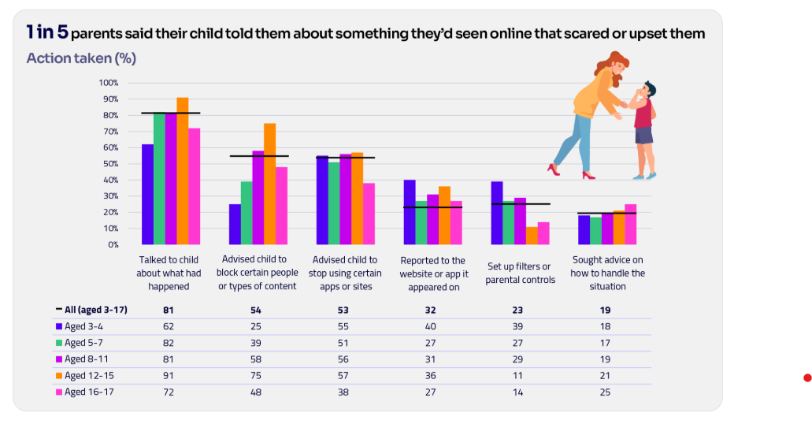
Are you CONFIDENT to TALK TO YOUR CHILD?
Is your child confident to TALK TO YOU?
WHAT WOULD YOU DO?
Are there any areas you would not feel confident or comfortable to discuss?
Younger children are more likely to tell someone if they see something worrying or nasty online:
  Two-thirds of 8-11-year-olds say that they would always tell someone (66%)
  Almost half of 12-15s and 16- 17s (49% and 45% respectively).
Source: Children and parents: media use and attitudes report 2024
Notes:
Four in five parents (81%) chose to talk to their child about what had happened.
Just over half advised their child to block a specific type of content or person (54%) or who recommended that their child stop using certain apps or sites (53%).
However, only a third of parents in this situation (32%) suggested reporting the content to the site or app on which it appeared.
TELL:
You do not need to be an IT expert to help your child stay safe online. One of the best things you can do to protect your children is to talk regularly with them about their use of technology- just as you do with all other areas of parenting.
Having an open and honest approach is best - reacting, without involving them or talking to them, can often push behaviour underground, so it still happens, but you are less likely to know about it. This can increase risk to your child.

Slide 7



YOU don’t need to be an EXPERT … be a PARENT
It’s your choice - Don’t let others dictate when the right time is to use tech.
Stay involved – make time to communicate, talk about what they are doing. What do they enjoy? What makes them laugh?
Don’t quiz them – have regular conversations. What's their favourite app? What is the best site to learn new things from?
Join in - watch them play a game and join in. Who are they playing with? Do they know the other players?
‘Show me how…’ – ask their advice to help you with your privacy settings, who you should add as a friend, are there any risks?
Lead by example - children learn as much from watching as they do from being told not to do something, so model good behaviour
Reassure them - tell them that they won't get in trouble and that you are always there to help.
Notes:
ASK – What do you do that works well? Share good practice
REMIND - You do not need to be a tech expert to help your child with staying safe online. It’s ultimately about communication and being proactive.

Slide 8
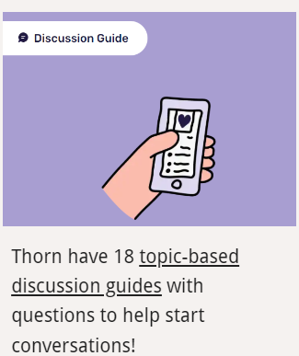
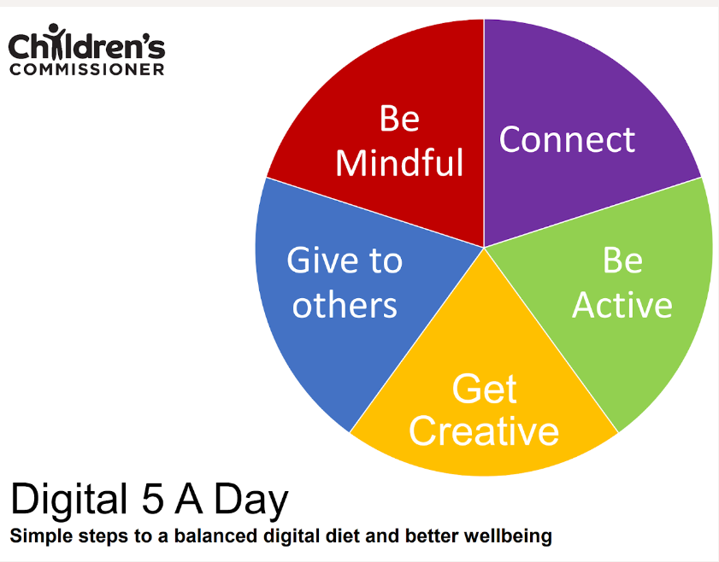




Find conversation starters, story time ideas and top tips to reinforce key safety messages at parentsafe.lgfl.net
Notes:
Feel free to point out some of these free resources for parents to reinforce safety messages and start those key online safety conversations:
TELL:
For younger children, it’s important to talk about boundaries, being kind to others and what they can do if they see or experience anything that worries or upsets them. Story time books e.g. ‘The Online Zoo’ and ‘#Goldilocks – a Fairytale for the Digital Age’ are great ways to discuss risk, consequences and positive strategies in a non-judgemental, age-appropriate way.
For older children, Thorn have 18 topic-based discussion guides with questions to help start conversations!

Slide 9
DEVICE USE AND OWNERSHIP

Slide 10
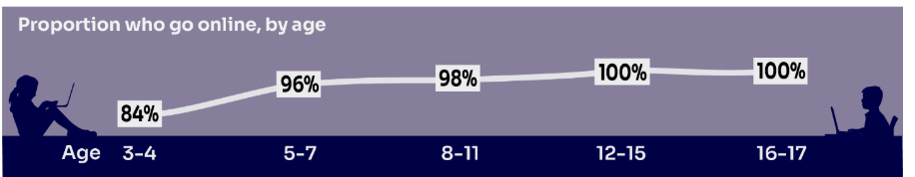

HOW MUCH DO YOU KNOW about your child’s life online?
Almost all children (96%) aged 3 – 17 went online in 2023, highlighting the centrality of the internet in their lives:
    Younger children commonly use tablets to go online
    Older children are more likely to use mobile phones
Source: Children and parents: media use and attitudes report 2024
Notes:
TELL:
We will be looking at 3–17-year-olds patterns of media use, how they access different sources of media online, and the types of online activities they are participating in. This includes their behaviours and habits in terms of viewing, playing, learning, and interacting
Almost all children from aged 5yrs (96%) went online in 2023, highlighting the centrality of the internet in children’s lives.
And we mustn’t forget that being online does create a lot of opportunity and joy for most of us. So, let’s think about how we can minimise risk and reduce their exposure to harm.

Slide 11
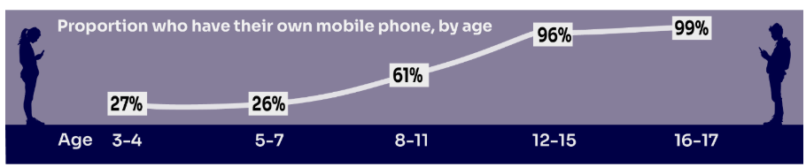
Does your child have their OWN MOBILE PHONE? If so, is it a SMART PHONE?
What AGE do you think is appropriate?
Source: Children and parents: media use and attitudes report 2024
Notes:
TELL - A common debate is about the age at which children should be able to use smartphones. These are mobile phones that can access the internet and have apps installed on them. Some parents have opted for non-smart’ phones, which are mobiles that usually only have text and call capabilities.

Slide 12


SMARTPHONE or ‘NON’-SMART / BRICK phone?
REMEMBER IT’S YOUR CHOICE
Every child and situation is unique,
and you are best placed to know their needs
Internet access
Social media, apps and games
Notifications
Anytime connection
Parental controls
NO internet access
Some games
Anytime phone calls and texts
Limited parental controls
Notes:
ASK THEM TO CONSIDER:
How will they reduce any risks?
What does their child need the mobile for? Is it simply to stay in touch with you - then a ‘non-smart’ phone might be enough. But if you want them to access homework or learning on their mobile, then a smartphone might be better.
How you can help them child learn the basic skills to use it safely e.g. to send a message, take part in a group chat, manage their timings etc. Children need our support with developing these skills. You wouldn’t give your child a knife without guidance and support, similarly a phone can cause harm and so need to think about this.
Whatever they decide, communication is key - involve the child in the process to establish shared expectations.
Remember to set up parental control settings or use a parental controls app to help them stay safe.

Slide 13

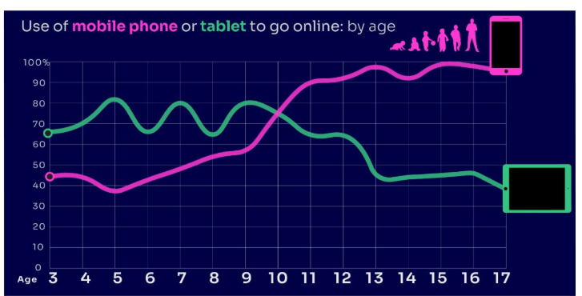
By age 11, nine in ten children own their own mobile phone, distinct from using a family device
This correlates with transition from primary to secondary school.
Source: Children and parents: media use and attitudes report 2024
Notes:
As in previous years, the point at which it becomes more likely that a child will go online using a mobile rather than a tablet closely correlates with the age at which mobile phone ownership among children becomes almost universal.

Slide 14
SUPERVISION AND PARENTAL CONTROLS

Slide 15
What RULES do YOU SET about being online?
Spending money online (52%)
Who you can interact with online
Information their child can share online (49%)
While parental concerns in some areas have increased considerably, their enforcement of rules appears to be diminishing, partly because of resignation about their ability to intervene in their children’s online lives.
Where and when devices can / can’t be used
Types of websites and apps they can use (41%)
Video content their children are allowed to watch online (67%)
Source: Children and parents: media use and attitudes report 2024
Notes:
ASK: What rules do you set for your children? How confident are you in implementing them?

Slide 16

Why not have a family agreement to:
clarify what is allowed...or not
establish ground rules like no phones at the table or in the bedroom at night-time
agree shared expectations to reduce arguments and keep everyone safe & healthy
Download it at parentsafe.lgfl.net/digital-family-agreement
Notes:
TELL:
To help facilitate this, LGfL have created a free digital family agreement that parents could sit down and populate with all family members to agree what is and is not allowed within their family around tech use. This includes parents! WE as parents also need to role model good behaviour.

Slide 17
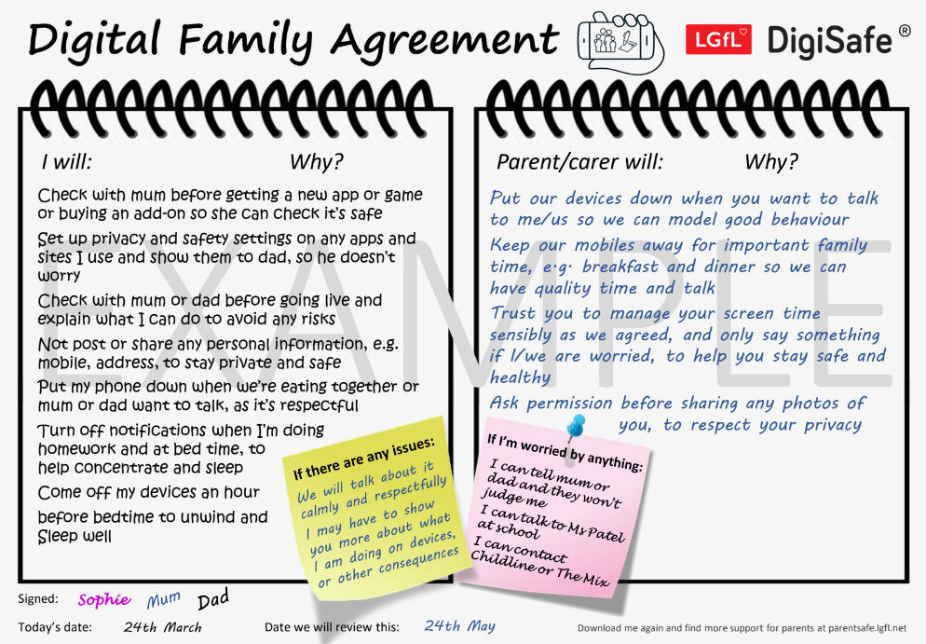
SHARENTING!
parentsafe.lgfl.net
Notes:
TELL - This is an example of a completed agreement – you may wish to take them through the sample statements to help them get started.
ASK – Have they heard of the term ‘Sharenting’?

Slide 18

What’s wrong with SHARENTING?
(when parents share photos of their children online)
Identity theft
Permanence of digital content
Losing control of images
Exposure to child predators
Creates their children’s digital footprints before they are old enough to consent to it
Notes:
TELL:
Sharenting is when parents share photos of their children online. Usually, images are shared on social media platforms to capture memorable moments in children’s lives, such as first steps, trips to the zoo, school performances, and holidays.
more than 75% of parents have shared their children’s images on social media, and 33% have never asked their children for permission before sharing photos online.
EXPLAIN THE RISKS:
Identity theft - sharenting habits expose incredible amounts of personal information about their children. More than 80% of parents use their kids’ real names on social media posts.
Permanence of digital content – even if a post is deleted, someone could have taken a copy, which could put the child at risk or lead to bullying or teasing in the future
Losing control of images - most social media sites own any content posted to their platforms. This clause is usually hidden in the terms and conditions that most users scroll through without reading. This means the platform on which it is shared has ownership of the image.
Exposure to child predators - images parents share can contain information that allows predators to track children. E.g. school or uniform, street name of the family home, while geotags can allow people with nefarious intent to track the child’s real-time location. In addition, because parents cannot control how far these photos spread, it is impossible to know where they end up, even with privacy controls in place.
Since sharenting essentially creates their children’s digital footprints before they are old enough to consent to it, the practice can also create privacy issues between children and parents that can erode trust in that relationship. For all these reasons, it is important for parents to think twice before posting about their kids.

Slide 19
Do you SUPERVISE your child’s online activity? HOW?
UNDER 12
More likely to be nearby / regularly check what their child does online
(59%)
12 - 15
Ask their child about what they are doing online
(72%)
16 - 17
Ask their child about what they are doing online
(42%)
Source: Children and parents: media use and attitudes report 2024
Notes:
TELL - The two most commonly-employed types of parental supervision among parents of 3-17s are to:
ask their child about what they are or have been doing online (59%), and
be nearby and regularly checking what their child does (55%).
Of course, this varies as the child gets older and more independent. For instance, until the child reaches the 12-15 age band, the most common method of supervision is to be nearby and regularly check what their child does. But for 12-15s and 16-17s, the most common method is to ask their child about what they are doing online (72% and 42% respectively).

Slide 20


Have you set up parental CONTROLS/PRIVACY SETTINGS for ALL DEVICES and NETWORKS?
Controls have to be set up on both the broadband connection AND each individual device
These do not come as standard so it’s worth checking
They are important because they allow you to:
  Block and filter upsetting or inappropriate content or sites
  Plan what time and how long your child can go online for
Notes:
TELL – it is important that these controls are set up on BOTH the broadband connection AND each individual device
About seven in ten (73%) parents of all 3-17-year-olds use at least one type of technical tool or control to manage their child’s access to online content; parents of 8-11-year-olds are more likely than those of older children to use at least one of these tools (84% vs 70% of parents of 12-15s and 54% of parents of 16-17s respectively). The most commonly-used technical tool used, across all parents of 3-17s, were parental controls built into the device by the manufacturer, e.g. Windows, Apple, Xbox, PlayStation etc. (32%). (Ofcom 2024)

Slide 21
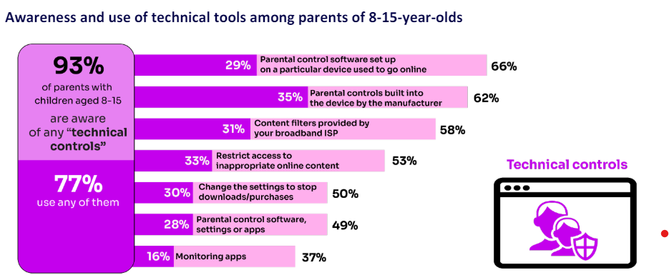
High awareness of technical control tools among parents, BUT many are choosing not to use them
WHY DO YOU THINK THIS IS THE CASE?
Around four in ten parents who know about content filters prefer to rely on their child’s ability to navigate online content rather than to have a technical filter
‘I prefer to supervise my child’s online use by talking to them about setting rules’
(39%)
Source: Children and parents: media use and attitudes report 2024
Notes:
TELL – it’s not as complicated or scary as you think. Let’s look at some top tips and resources to support you.

Slide 22

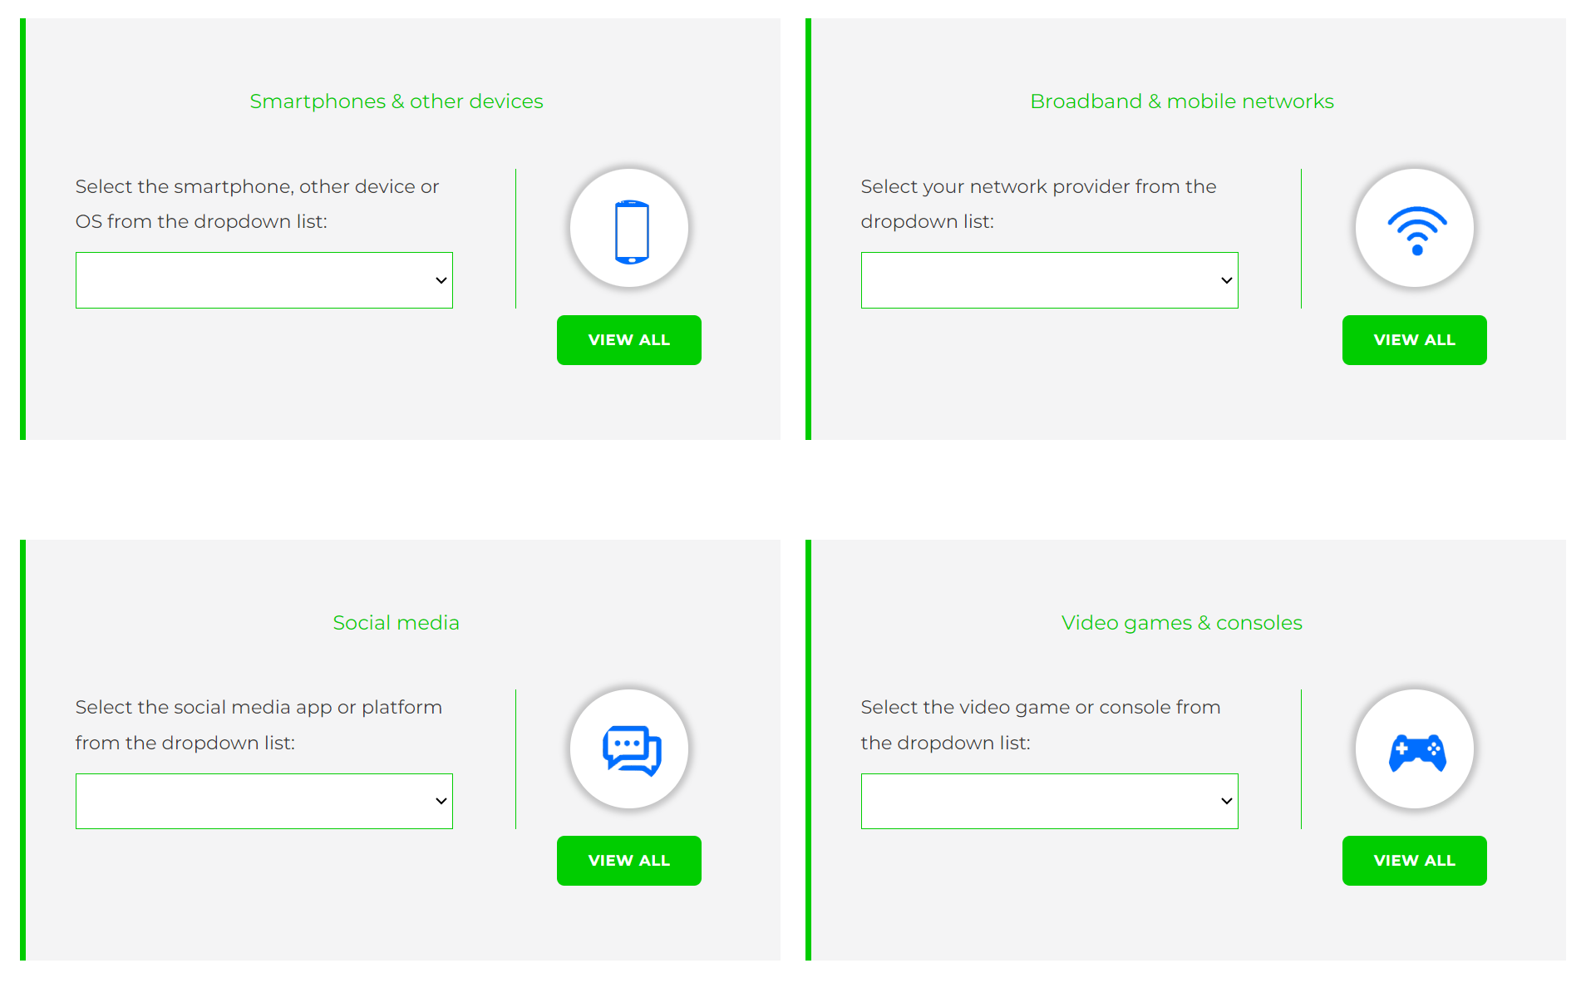
Visit www.internetmatters.org/parental-controls/ to find out how to set controls on devices:
Notes:
TELL – They can use this great page to find out how to set up controls on any smartphone, broadband, social media site/app and games console
REMIND - They need to set up parental controls on each of these individually

Slide 23

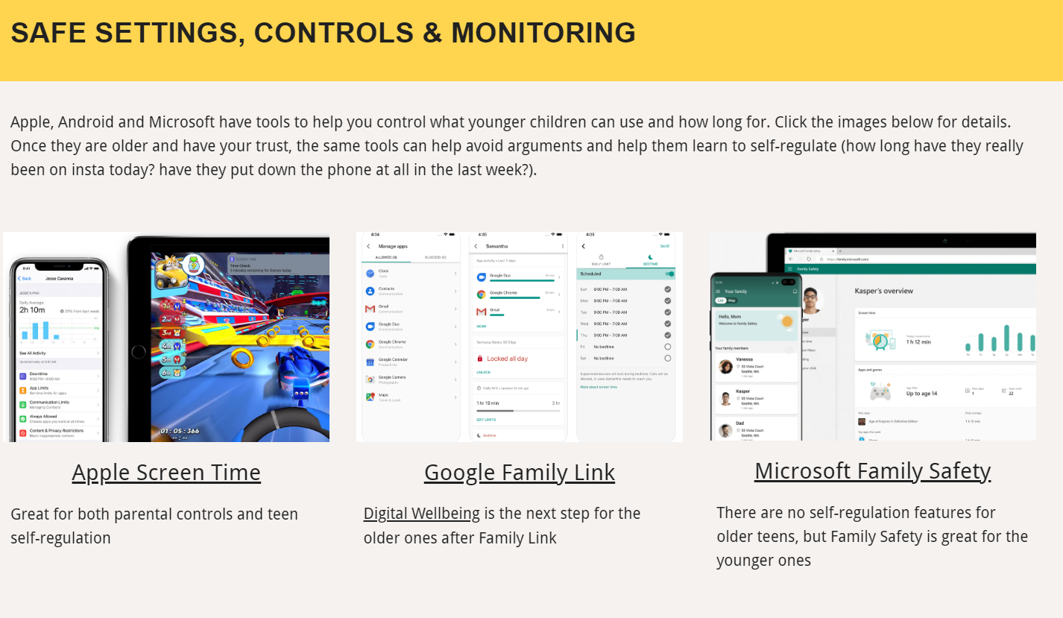
Parental control apps like Google Family Link, Screen Time and Microsoft Family can let you set limits across devices, apps and platforms
Visit parentsafe.lgfl.net/ for additional advice and tips on settings and controls for all devices
Notes:
EXPLAIN - As well as setting controls on your broadband, device, apps, games etc, Parental Control Apps like Google Family Link, Screen Time and Microsoft Family can further enhance safety by letting you set limits across devices, apps and platforms without needing to access these spaces separately. You can manage screen time, app access, inappropriate content restrictions and more.
Screen Time shows you how much time you spend on apps, websites and more. You can also set limits and restrictions for what you want to manage – on your own device or a child's device.
Family link can run on Android devices, e.g. Samsung… Parents can access and manage their child’s account and settings, and delete it if necessary
TIP – Why not run a ‘Bring your device and we’ll show you….’ pupil-led workshop to help parents with this at school?

Slide 24

REMEMBER
As children get older, restrictions and controls you use will change, but only at a pace you feel is appropriate for your child, not pressure from your child “because everyone else is allowed”
Content filters are never 100% effective, at some point your child may come across inappropriate or upsetting content, so make time to talk regularly

Slide 25
SCREENTIME

Slide 26

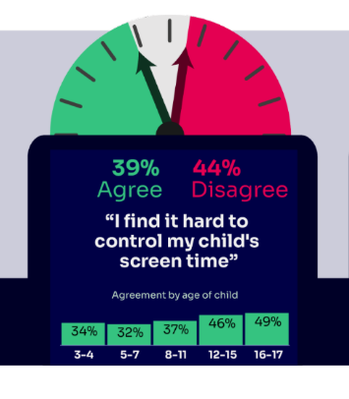
WORRIED about their SCREENTIME??
Do you know HOW LONG YOUR CHILD SPENDS online daily?
Children spent an average 3 hours 5 minutes per day accessing the internet, across smartphones, tablets and computers
Four in ten (39%) parents of children aged 3-17 report finding it hard to control their child’s screentime
Visit screentime.lgfl.net for advice and tips to manage screentime
Source: Children and parents: media use and attitudes report 2024
Notes:
Parents’ concerns about their child’s screentime increases with age - Overall, four in ten (39%) parents of children aged 3-17 report finding it hard to control their child’s screentime. This increases with age, going from a third (34%) for parents of 3-4-year-olds to half (49%) of parents of 16-17-year-olds.
Threequarters (74%) of parents aged 3-4 agreed that their child had a good balance, compared to just over half of parents of older children (56% and 55% for parents of children aged 12-15 and 16-17 respectively).

Slide 27
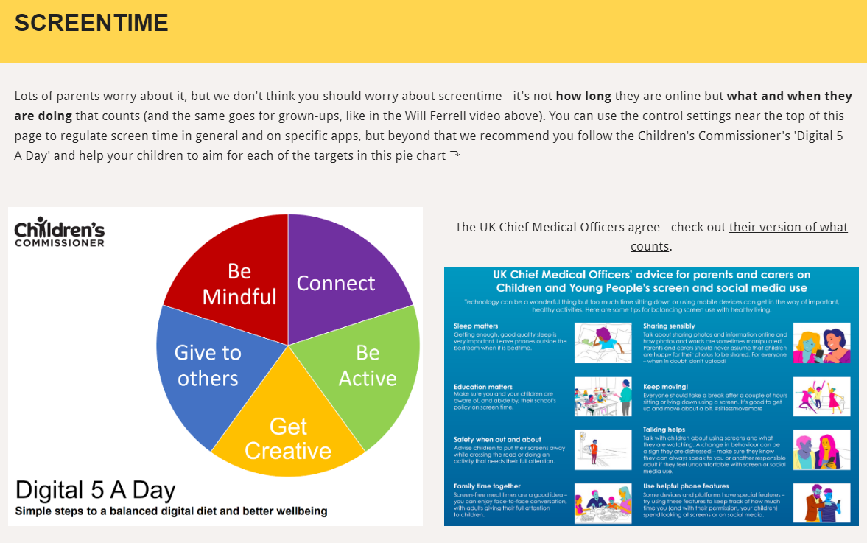
Visit parentsafe.lgfl.net/ for advice and tips to manage screentime
Notes:
ASK – Do you think lots of screentime is a bad thing generally? Why? How long is OK?
SHARE - World Health Organization (WHO) recommendations and research:
Infants (1 – 2 years) are recommended no screentime, whilst for 2 – 4-year-olds sedentary screen time should be no more than 1 hour; less is better.
When sedentary, engaging in reading and storytelling with a caregiver is encouraged
Improving physical activity, reducing sedentary screen time and ensuring quality sleep in young children will improve their physical, mental health and wellbeing, and help prevent childhood obesity and associated diseases later in life.
TELL – It’s not how long they are online but what and when they are doing that counts - take them through the UK Chief Medical Officer’s advice poster above for examples
EXPLAIN – the Digital 5 A day gives children and parents easy to follow practical steps to achieve a healthy well balanced digital diet, by encouraging them to reach of the targets in the pie chart – share some examples with them https://www.childrenscommissioner.gov.uk/digital/5-a-day/

Slide 28

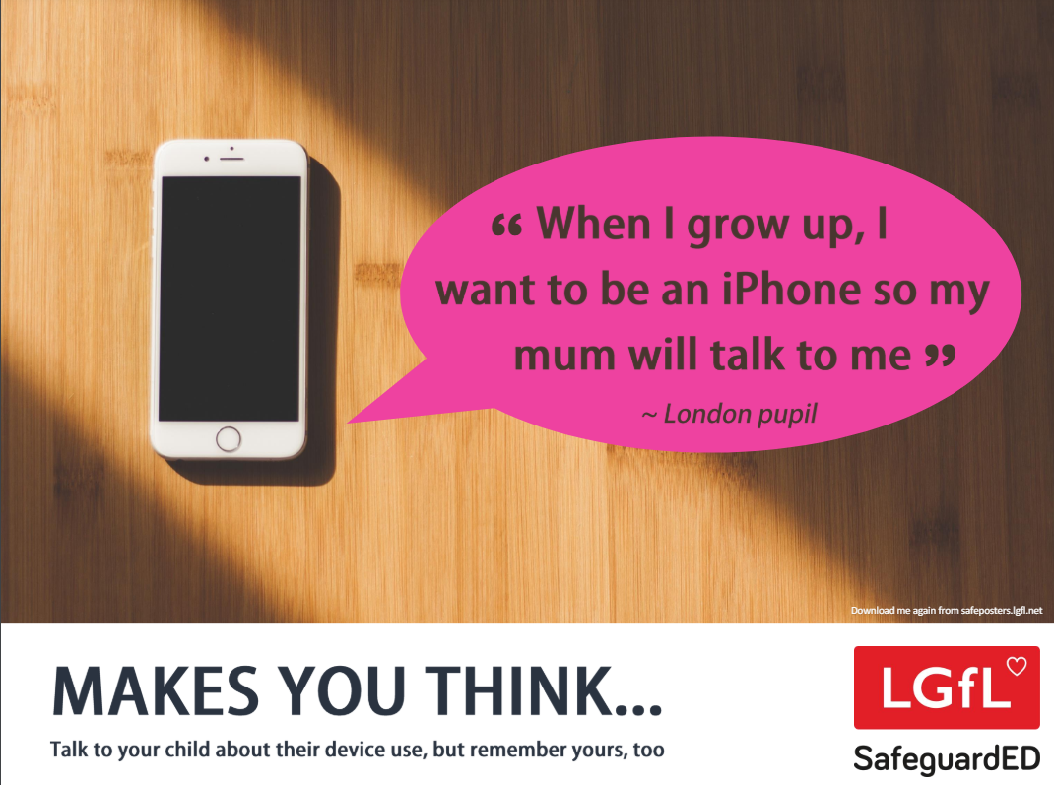
How does your child feel about YOUR SCREENTIME vs THEIRS?
45% of 8-11s feel that their parents’ screentime is too high
35% of 8-17s feel that their own screentime is too high
Source: Children and parents: media use and attitudes report 2024
Notes:
REMIND – it’s important to model good behaviour when it comes to device use, as children will follow our example. The same goes for ‘sharenting’ (see slide 22)

Slide 29
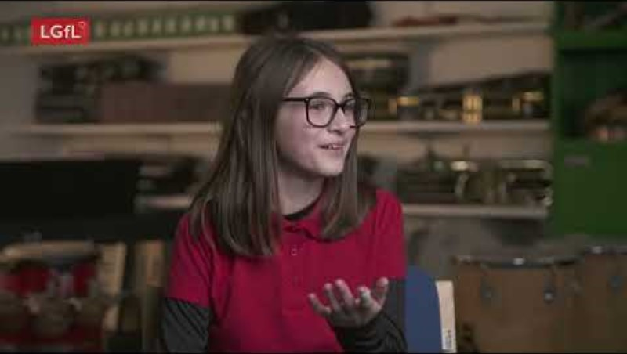
Notes:
PLAY VIDEO – ‘Life Online - What Grownups Just Don't Get!’
This video is part of our playlist on what children and young people actually think about some of the top topics and hot potatoes of the day in 2024. You can discuss key points from this to facilitate conversations to break down barriers to keeping children safe online.
https://youtu.be/Lde52EtjljQ?si=QZSHL0Gn31LRCO1T

Slide 30
SOCIAL MEDIA AND GAMING

Slide 31

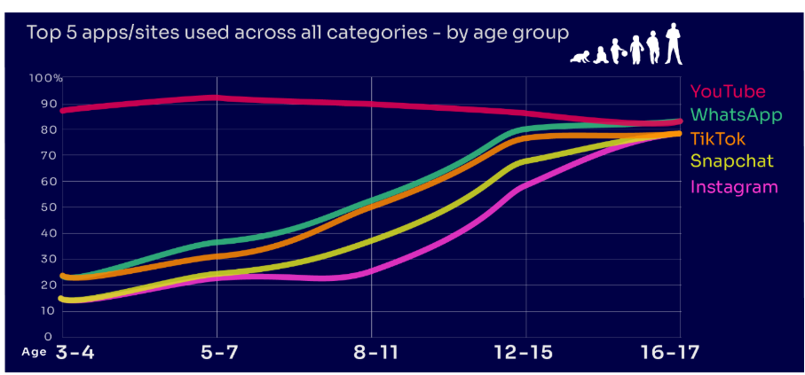
Are you FAMILIAR WITH THE APPS and GAMES your child is on?
YouTube is the most popular, but the appeal of many social media platforms varies by age
under two in ten of all 3-4-year-olds use Instagram and/or Snapchat
this rises to eight in ten among 16-17s
under a quarter of all 3-4-year-olds use WhatsApp
this rises to over eight in ten of all 16-17-year-olds
Go to apps.lgfl.net for guidance on apps and social media sites
Source: Children and parents: media use and attitudes report 2024
Notes:
YouTube is the most-used app or site among the children in our study, with more than eight in ten 3- 17-year-olds using it. However, while YouTube is a popular app across all age bands, some sites or apps grow in popularity with age. For example, just under two in ten of all 3-4-year-olds use Instagram and/or Snapchat (17% in each case) but this rises to eight in ten among 16-17s (for both apps). Similarly, just under a quarter (23%) of all 3-4-year-olds use WhatsApp, and this rises to over eight in ten (83%) of all 16-17-year-olds. This underlines the more interconnected and social nature of older children’s online behaviours; indeed, half (49%) of all 16-17-year-olds use all five of the top apps/sites (YouTube, WhatsApp, TikTok, Snapchat and Instagram).
REMIND – your children need to be 13+ to use these platforms (See slide 39)

Slide 32
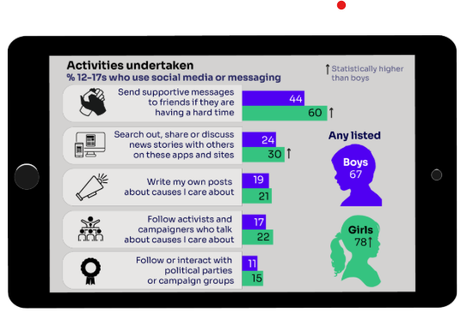
KNOW WHAT THEY DO on social media?
Eight in ten (81%) of all children aged 8-17 use at least one social media app/site for following friends, people and organisations, reading, liking or sharing content
Many used sites and apps like TikTok and Instagram to consume content
Snapchat was the most favoured platform to message and communicate with friends.
“I don’t think I could live without Snapchat anymore…. I’ve got all my friends on it, and we have like group chats where we all call, like, all the time, and we text each other and Snap each other” Suzy, 12
Go to apps.lgfl.net for guidance on apps and social media sites
Source: Children and parents: media use and attitudes report 2024
Notes:
TELL - Motivations for using these types of app vary, but a key reason is the desire to connect with peers. Seven in ten (68%) 8-17-year-olds who use social media and/ or messaging sites or apps told us that using these types of sites or apps helped them feel closer to their friends, either all or most of the time.

Slide 33
WHY DOES THIS MATTER?
Young people can get around age restrictions on apps and websites, increasing the risk of them coming to harm online
Many children have online profiles that make them appear older than they actually are – exposing them to content inappropriate for their age
Addictive algorithms can make it harder to take a break and maintain a healthy balance between time on and offline
Algorithms can also target content similar to what you’ve already selected/liked/shared. This can prevent you from finding new ideas and perspectives, create misinformation and reinforce stereotypes.
Notes:
ASK – What kinds of risks do you think children could be exposed to? Can you give examples? (See slide 48 for a summary of related risks)

Slide 34

What might they NOT BE TELLING YOU?
Nearly six in ten (58%) 8-17s use multiple profiles on at least one social media platform:
(23%) said it was because one account was just for parents/family to see
13% said one account was for the ‘real me’ and another contained edited/filtered posts or photos
Source: Children and parents: media use and attitudes report 2024
Notes:
TELL - This demonstrates that at least some children feel the need to present distinct aspects of themselves on social media, depending on the audience.

Slide 35

What about WHATSAPP?
Do you know the minimum age to use this?
What are the risks?
Unwanted contact | to contact somebody on WhatsApp, all you need is their phone number, which could expose you to unwanted messages or calls
Inappropriate content | messages are end-to-end encrypted which means that the content cannot be monitored. This means that your child could see or hear harmful or upsetting content e.g. pornography or violence.
Location sharing | live location feature means that your child could reveal their current location to others
Cyberbullying | children could be bullied, feel left out or deliberately excluded or removed from groups
Oversharing | privacy features, such as disappearing and ‘view once’ messages, might mean that your child feels safe to reveal private or risky information or images. However, there is always a risk that this could be copied and shared
Notes:
TELL - WhatsApp let users send messages and content to contacts added to their account. To use the service in the UK, users must be 13-years-old or older (as of April 2024. The minimum age for WhatsApp used to be 16)

Slide 36

Notes:
PLAY – ‘What's Up on WhatsApp? Group Chats and Kicking’ video showing primary pupils talking about the realities of group chats and exclusion bullying - deliberately being left out to hurt someone's feelings.
https://youtu.be/BpT8vFn6_eA

Slide 37
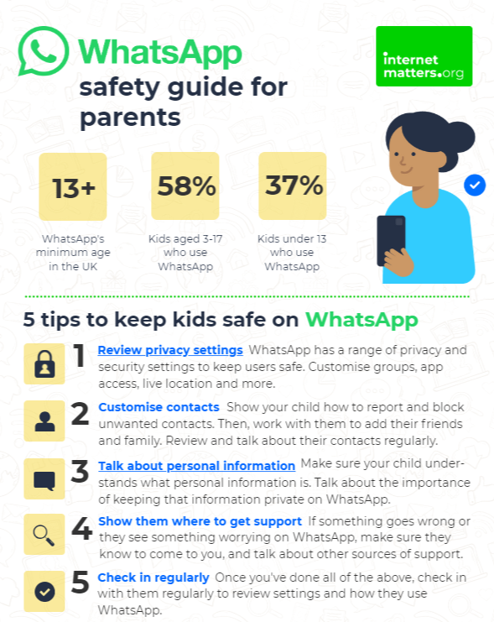
What can you do?
Visit https://www.internetmatters.org/resources/whatsapp-safety-a-how-to-guide-for-parents/#whatsapp-safety-tips for advice for parents
Notes:
SHARE – 5 top tips from the parent safety guide at https://www.internetmatters.org/resources/whatsapp-safety-a-how-to-guide-for-parents/#whatsapp-safety-tips
EXPLAIN – it’s useful to talk with children about etiquette when using group chats e.g.
how to communicate
what language to use/not use
recognition that others may see your messages if copied and shared
what to do if someone is unkind to them or others etc.

Slide 38
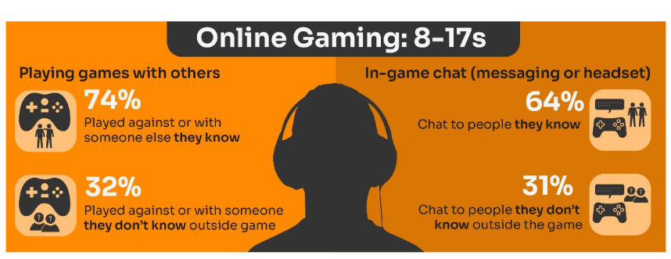
Do you know the DIFFERENCE between an ‘ONLINE’ FRIEND and a real one? How does this differ from your CHILD’S VIEW?
Are you familiar with who they are in contact with whilst playing games?
Have you asked about the chat facility?
Do you know the content and age restrictions for these games?
Visit gaming.lgfl.net for advice and activities
Source: Children and parents: media use and attitudes report 2024
Notes:
TELL:
Children often use online gaming as a tool to communicate with their peers, with 64% of 8-17s who game online chatting through the game with friends and/or people they know in real life.
However, 31% of children who game online, communicate with strangers as well.
A higher proportion of these children now play shooter games than last year (15% vs 10% in 2022). This may raise concerns about how age appropriate the games favoured by some younger children actually are.
Gaming is a central part of many children’s lives, and this year we have seen an increase in the already high proportion of children who game online, rising from 57% of all 3-17s in 2022 to 60% this year. This increase is driven by children at both ends of the age bands in Ofcom’s study: since 2022, we have seen increases in the proportion who play games online among 3-4s (23% vs 18%) and 5-7s (41% vs 34%) as well as among 16-17s (79% vs 72%). As in previous years, more boys aged 3-17 game online than girls of the same age (71% vs 58%).

Slide 39
How can YOU GET INVOLVED?
ASK what type of games your child enjoys – are they age-appropriate?
PLAY games together - keep the tech in shared spaces rather than bedrooms
TALK about who they are playing with - what information are they sharing?
EXPLAIN what is/isn’t appropriate to share, e.g. personal details to identify them/location
AGREE how they will spend their money online
DISCUSS what they would do if they were bullied online, and what steps to take
DECIDE how long is appropriate to play in one session - how many sessions a day
SETUP these restrictions in parental settings with your child
Visit gaming.lgfl.net for advice and activities to keep them safe
Source: Children and parents: media use and attitudes report 2024

Slide 40
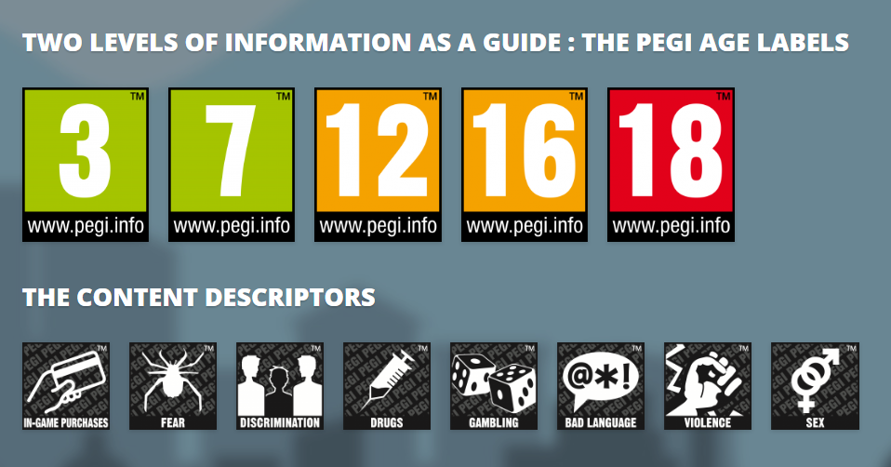
PEGI helps parents to make informed decisions when buying video games:
The age rating confirms that the game content is appropriate for players of certain age
It considers the age suitability of a game, not the level of difficulty
pegi.info
Notes:
UK uses the PEGI (Pan European Game Information) system to give games their age ratings to help people make informed decisions when buying video games or apps through the use of age recommendations and content descriptors. .You can find out more here: https://parentzone.org.uk/article/pegi-games-ratings#:~:text=The%20UK%20uses%20the%20PEGI,about%20how%20PEGI%20classifies%20games.

Slide 41
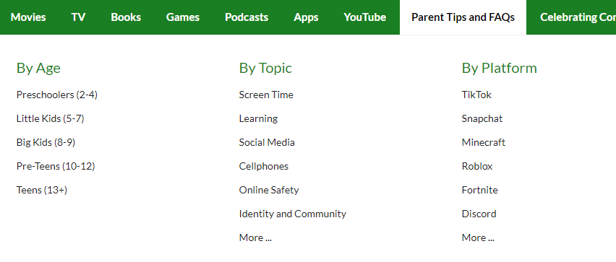


Find ratings and reviews for parents on apps, games and social media at commonsensemedia.org
Notes:
REMIND – they don’t need to be experts, but they can empower themselves by finding out about the suitability of the games/apps their child uses
SHOW – the Common Sense Media page and pick an app or game to show how easy it is to find a review

Slide 42

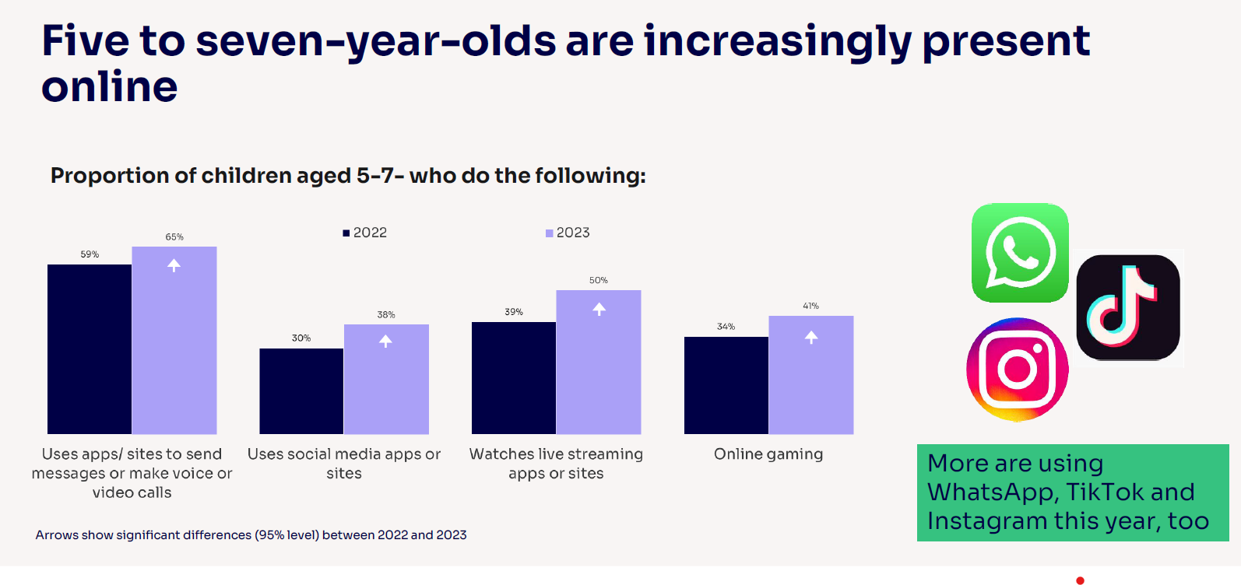
Notes:
Five-to-seven-year-olds are becoming increasingly present online, which may pose greater risks for them: Compared to last year, a higher proportion of all 5-7s use apps/sites to do each of these activities:
send messages or make voice/video calls (from 59% to 65%)
use social media apps or sites (from 30% to 38%)
watch livestreaming apps or sites (39% to 50%)
game online (34% to 41%).
Children this age are also more likely to use WhatsApp (37% vs 29%), TikTok (30% vs 25%), Instagram (22% vs 14%) and Discord (4% vs. 2%) compared to last year.

Slide 43
5–7-year-olds are also independent in their use of certain sites/apps!
Many have their own profiles on several social media platforms:
YouTube/YouTube Kids (48%)
WhatsApp (11%)
Instagram
(9%)
32% of parents reported that their child uses them on their own:
Three in ten (30%) agreeing they ‘would allow [their] child to have a profile on these sites or apps before they had reached the minimum age
Parents increasingly likely to say they would allow their child to have a social media profile
Notes:
Linked to this, Ofcom ask parents of children who use social media apps/sites whether their child uses these independently or not, and 32% of parents of 5-7s in this category reported that their child does use them on their own, with a further 42% of parents saying they use social media with their child. Therefore, 5-7-year-olds are not only increasingly present online, but some are also independent in their use of certain sites/apps.

Slide 44
RISKS AND NEGATIVE EXPERIENCES

Slide 45
So what are the RISKS?
content: being exposed to illegal, inappropriate, or harmful content, for example: pornography, fake news, racism, misogyny, self-harm, suicide, anti-Semitism, radicalisation, and extremism.
contact: being subjected to harmful online interaction with other users; for example: peer to peer pressure, commercial advertising and adults posing as children or young adults with the intention to groom or exploit them for sexual, criminal, financial or other purposes
conduct: online behaviour that increases the likelihood of, or causes, harm; sharing and receiving explicit images (e.g. nudes and semi-nudes and/or pornography and online bullying
commerce: risks such as online gambling, inappropriate advertising, phishing and or financial scams
Keeping Children Safe in Education
Notes:
TELL - The 4 Cs of online safety is a useful way to identify online safety risks for children (content, contact, conduct and commerce)
We will now take a look at some of these in more detail over the next few slides

Slide 46
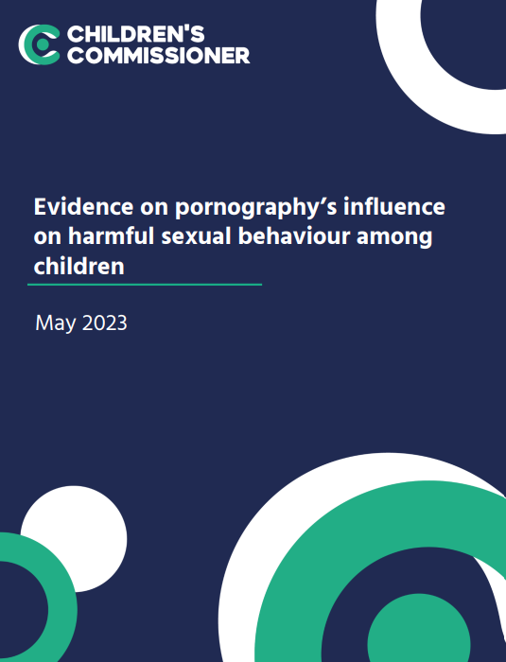
Average age children first view pornography is 13
Substantial proportions viewed it at a much younger age– 27% by age 11 and 10% by the age of 9
Unbearable pressure to view hardcore pornography even if they do not want to
Degrading acts and violence against women
Think it is reflective of real life or healthy relationships
Pornography sites are not the only way, or even the most popular way, that young people access online porn
Wide prevalence of on social media platforms such as Twitter, Snapchat and Instagram
Source: https://www.childrenscommissioner.gov.uk/resource/pornography-and-harmful-sexual-behaviour/

Slide 47
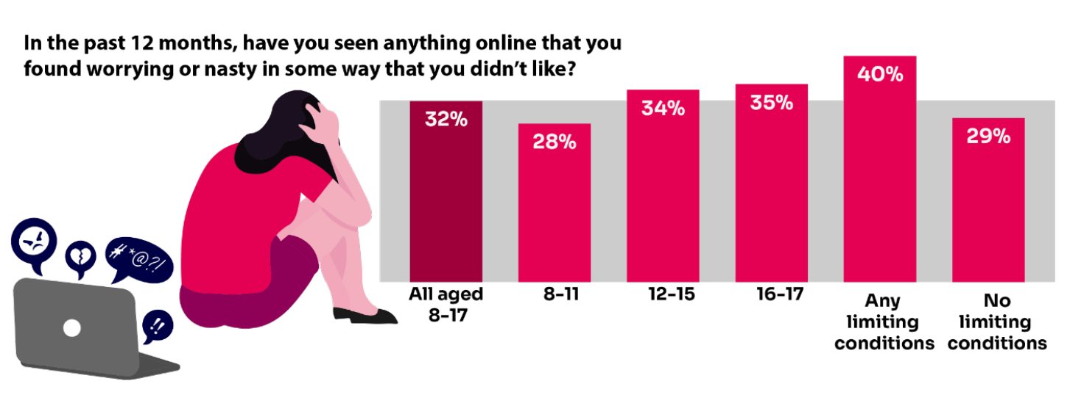
Summary of children’s negative experiences:
BUT Only 20% of parents report their child telling them about this in the same time frame.
Source: Children and parents: Media use and attitudes report 2023
Notes:
TELL:
A third of 8-17-year-old children are being exposed to content online that they find worrying or nasty, but only 20% of parents report their child telling them they had seen something online that scared or upset them in the same time frame.
The likelihood of children seeing this type of content increases with age - just over a third of 12-17s say they have been exposed to this type of content in the past year (34%) compared to 28% of 8-11-year-olds.

Slide 48
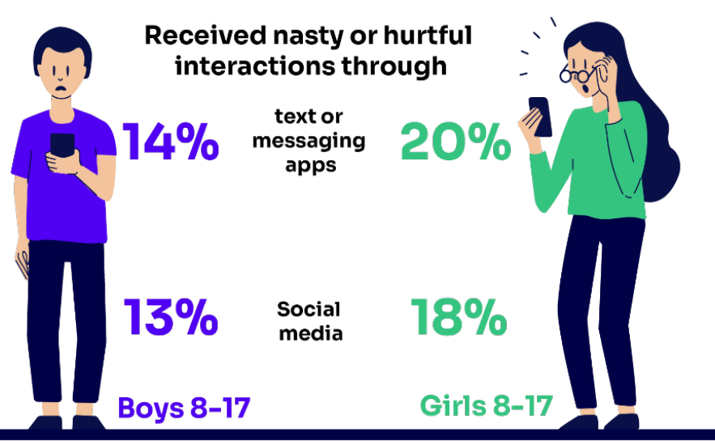
Bullying
Increase in the proportion who have experienced bullying via social media apps/sites (18% vs 15% in 2022)
girls are more likely than boys
Source: Children and parents: Media use and attitudes report 2023
Notes:
Three in ten of all 8-17s (31%) have experienced bullying via communications technology, compared to less than two in ten (18%) who have experienced it face-to-face. These two experiences are not necessarily mutually exclusive, and some bullying may be carried over between the online and offline worlds. While we have not seen any movement in these overall proportions since last year, we have noticed an increase in the proportion of all 8-17s who have experienced bullying via social media apps/sites (18% vs 15% in 2022).

Slide 49
Nudes / Semi-Nudes
Older girls (aged 16-18) were more likely than boys to have ever been exposed to potentially uncomfortable or unwanted types of contact:
  Asked to share naked/half-dressed pictures of themselves 24% (2023) vs 9% (2022)
  Receiving pictures or videos of naked / half-dressed people
  32% (2023) vs 11% (2022)
Source: Children and parents: Media use and attitudes report 2023
Notes:
The Online communication among children quantitative research study found that older girls (aged 16-18) were more likely than boys of the same age to have ever been exposed to all ten of the potentially uncomfortable or unwanted types of contact about which they were asked. These include receiving pictures or videos of naked/half-dressed people (32% vs 11%) and being asked to share naked/half-dressed pictures of themselves (24% vs 9%).

Slide 50
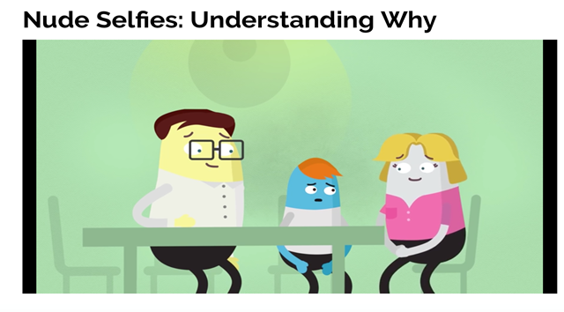
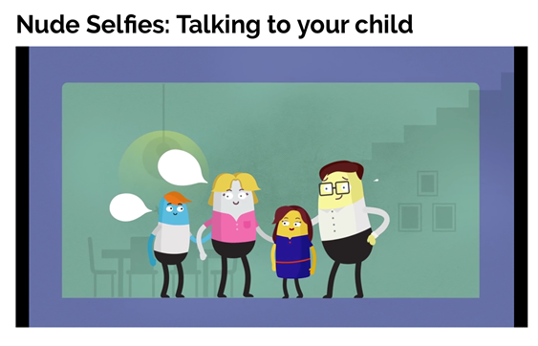
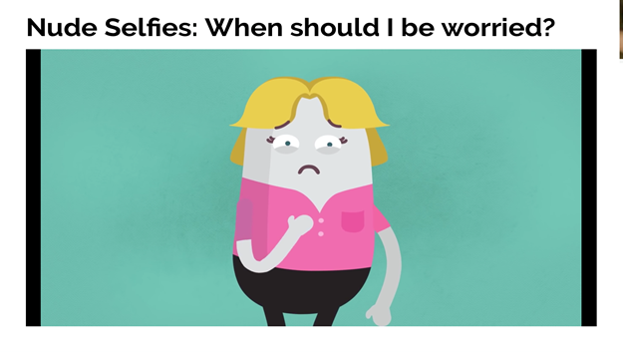
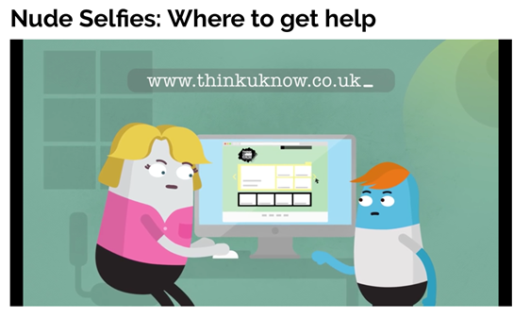
So, what can YOU do?
youtu.be/XjV0lKYpakk?si=6ONdtZJRjfB6bSRj – what parents and carers need to know
youtu.be/E5LA2nKHVZ0?si=gU3_jXFF51TU3vTq – when should you be worried?
CEOP
Notes:
SHARE – play relevant video to encourage discussion:
youtu.be/XjV0lKYpakk?si=6ONdtZJRjfB6bSRj – what parents/carers need to know
youtu.be/E5LA2nKHVZ0?si=gU3_jXFF51TU3vTq – when should you be worried

Slide 51
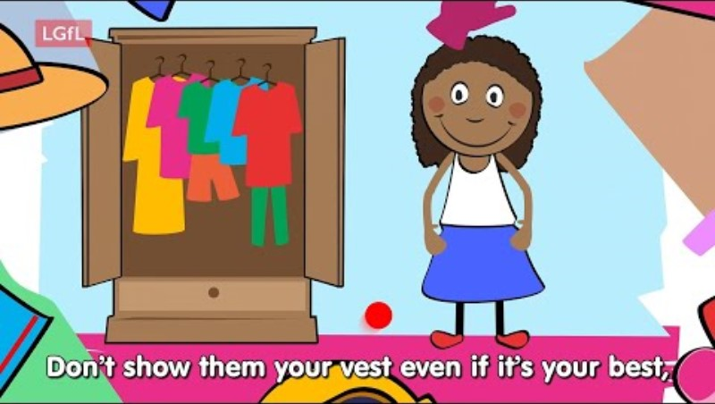
So, what can YOU do?
undressed.lgfl.net
Notes:
TELL - LGfL have created this series of resources which are appropriate for very young children, the dangers of taking your clothes off if you are using a device.
PLAY – Undressed video: https://undressed.lgfl.net/

Slide 52
STAYING SAFE ONLINE AND REPORTING

Slide 53
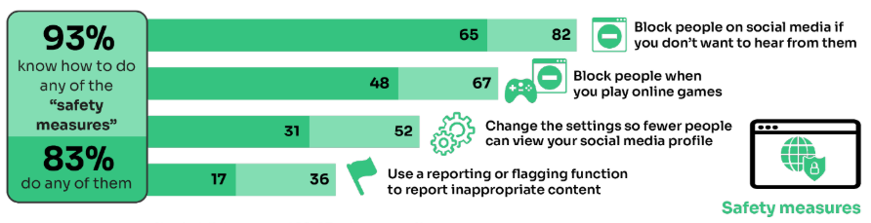
What do YOUNG PEOPLE do to STAY SAFE ONLINE?
Only 17% had used a reporting or flagging function
(36% were aware of these functions)
Go to reporting.lgfl.net to find out how to remove content from social media and where to report bullying, racial hatred, terrorism, sexual abuse and more
Source: Children and parents: media use and attitudes report 2024
Notes:
TELL - It is positive that children generally know about safety measures, but there seems to be a gap in their knowledge about reporting and putting the knowledge into practice.

Slide 54
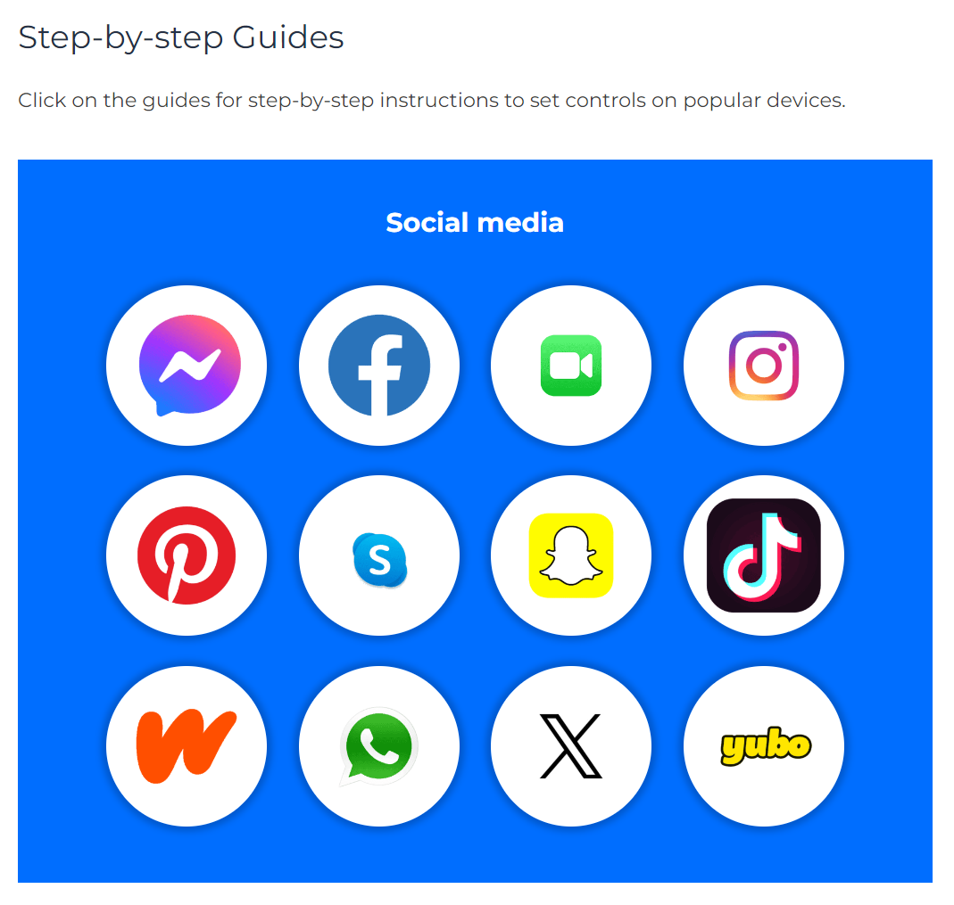
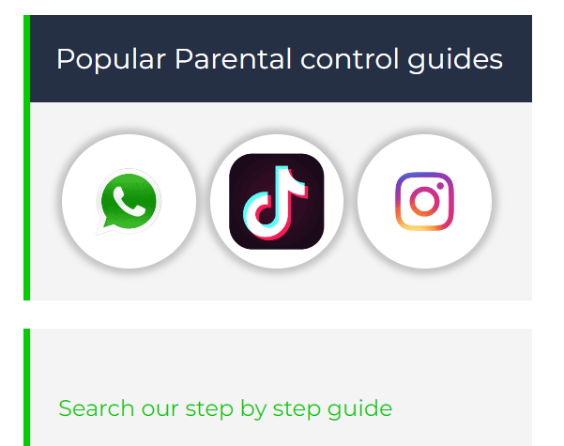
Do YOU know HOW TO REPORT to apps / sites?
Internet Matters has helpful guides for social media apps and sites at internetmatters.org/parental-controls/social-media
Notes:
Each social media site has it’s own processes for reporting inappropriate/harmful content.

Slide 55
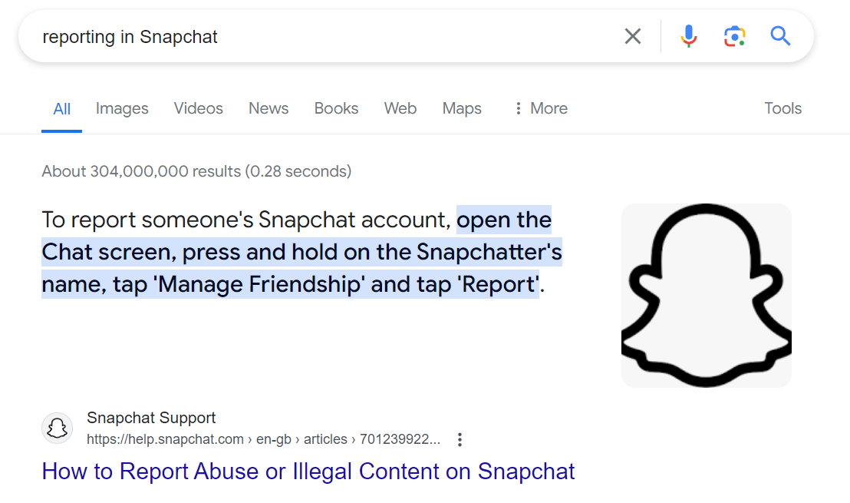
A simple Google search with the site name, e.g. ‘reporting in Snapchat’ will bring up the steps to take and signpost to the reporting page
Notes:
TELL – you can also do a Google search by typing ‘reporting in______________________________ (name of platform)’

Slide 56
Remember!
Before signing up to any app/site, check that your child meets the minimum age requirement for the platform to understand the risks
Remind your child to be cautious about accepting friend requests - a real friend is someone they/you know in real life, not a ‘friend’ they met gaming or in a chat room. Encourage them to ask you for advice if they are unsure.
Stress the importance of not sharing personal information with online ‘friends’
Keep passwords confidential
Check their privacy settings, emphasising the importance of not sharing personal information with strangers, and emphasising the confidentiality of passwords are all important steps
You can report any content, e.g. a post, image or harmful, misleading or damaging comment
Remember that reporting doesn't guarantee immediate removal, as platforms assess reported content based on their respective rules and policies

Slide 57




UK Reporting Helplines and Services for Children and Young People
NCA
Young people can report concerns about child sexual abuse and exploitation to NCA
Report Remove
A free tool that allows children to report nude or sexual images and videos of themselves that they think might have been shared online
ChildLine
A free, private and confidential service where CYP can talk about anything to a trained counsellor, online or on the phone
Call 101 or 999 if there is an immediate risk of harm to your child
Go to reporting.lgfl.net to find out more
Notes:
TELL – Talk to your children about these free reporting helplines to support them if they are worried.
For older children, The Mix provides help for young people aged 11-25

Slide 58
RESOURCES AND SUPPORT

Slide 59
For Children in Early Years or Key Stage 1 or Lower Key Stage 2 this is an excellent resource that you can purchase online for £3
Help keep children safe online with Techosaurus! | NSPCC
Online safety quiz | NSPCC
For children in Upper Key Stage 2

Slide 60

Visit parentsafe.lgfl.net for tips and ideas to help parents:
Manage screen time
Set controls and settings
Understand apps and games
Talk to children about risk - from bullying & sharing content, to extremism & gangs
Notes:
TELL:
Remember, the online world can be both exciting and treacherous. Just as you’d look both ways before crossing the street, take a moment to assess the digital landscape.
Stay informed, stay connected, but most importantly, keep talking to your child.
ParentSafe is a dedicated website for parents, to help them to stay up to date with online safety and empower them to have meaningful discussions with their child to keep them safe.

Slide 61
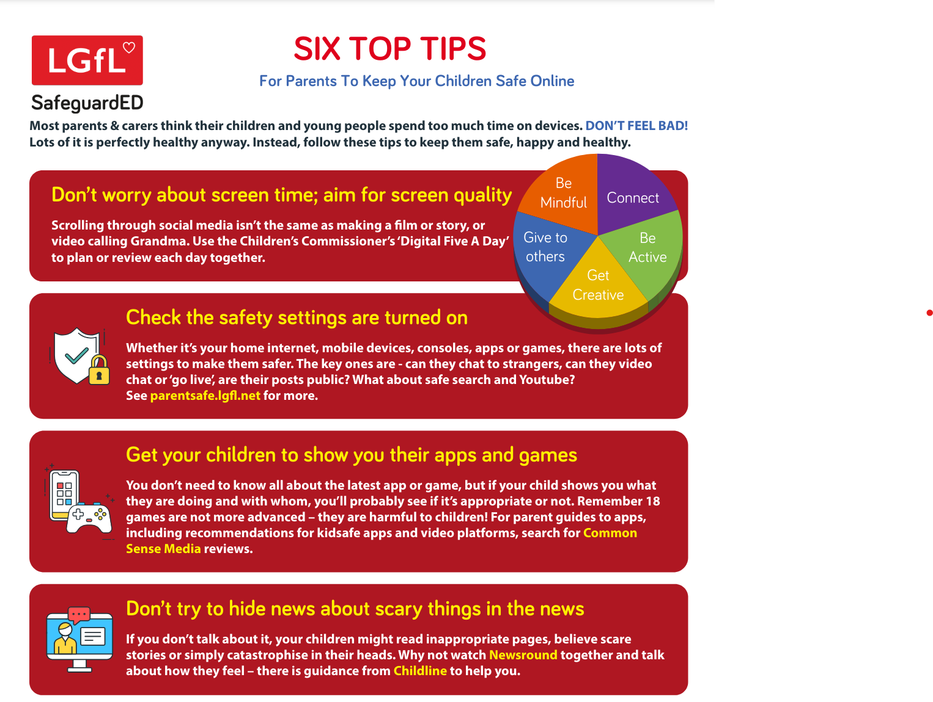
Notes:
TELL - why not put this fridge-friendly poster on your fridge?

Slide 62
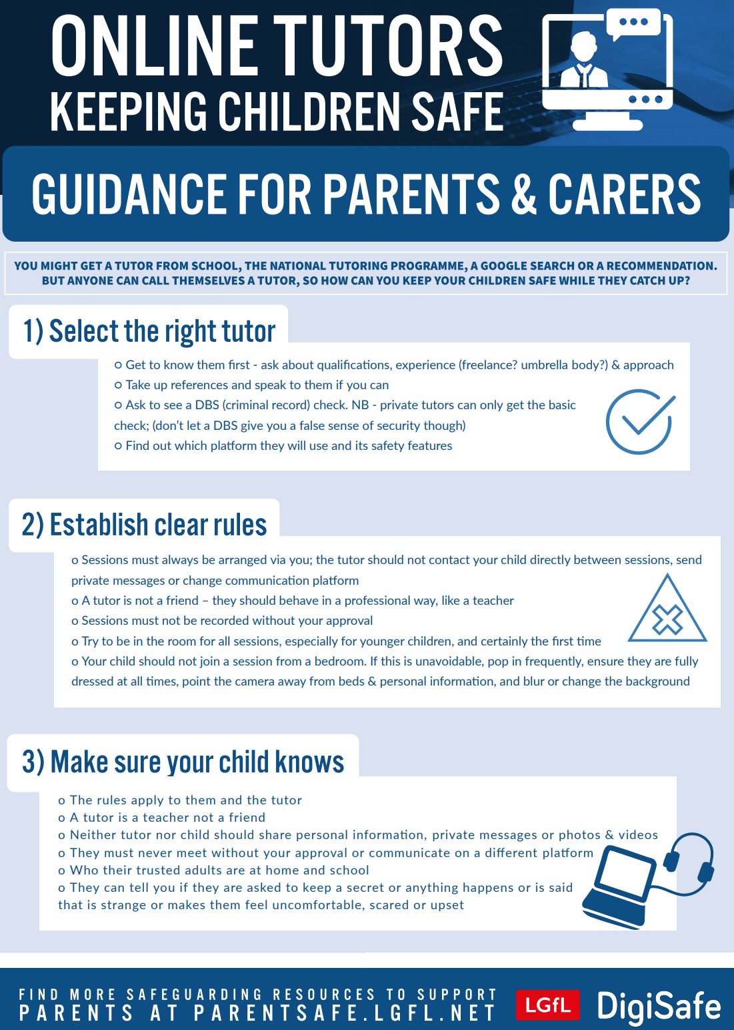
parentsafe.lgfl.net
Notes:
TELL - If you have an online tutor for your child, we have some useful tips and areas for consideration in this poster.

Slide 63
Why not have a family agreement to:
clarify what is allowed...or not
establish ground rules like no phones at the table or in the bedroom at night-time
agree shared expectations to reduce arguments and keep everyone safe & healthy
Download it at parentsafe.lgfl.net/digital-family-agreement
Notes:
TELL - LGfL have a free template of a digital family agreement that parents could sit down and populate with all family members to agree what is and is not allowed within their family around tech use. This includes parents! We need to role model good behaviour.
ASK – Can you think of any examples of how we as parents can model good behaviour?

Slide 64
parentsafe.lgfl.net
Notes:
TELL - This is an example of a completed agreement to help you get started
Go through some of the example statements and discuss ideas for parents to be good role models, e.g. no devices at the dinner table, asking permission before sharing their child’s images (this is SHARENTING - see slide 23 for more information about sharenting)

Slide 65
Where to get help?
St Leonard's, Heath and Reach, VA Lower School – Safeguarding
Safeguarding | Kensworth CE Academy
Notes:
Please amend this slide with anything further you want to tell parents about reporting concerns to the school and seeking help

Slide 66
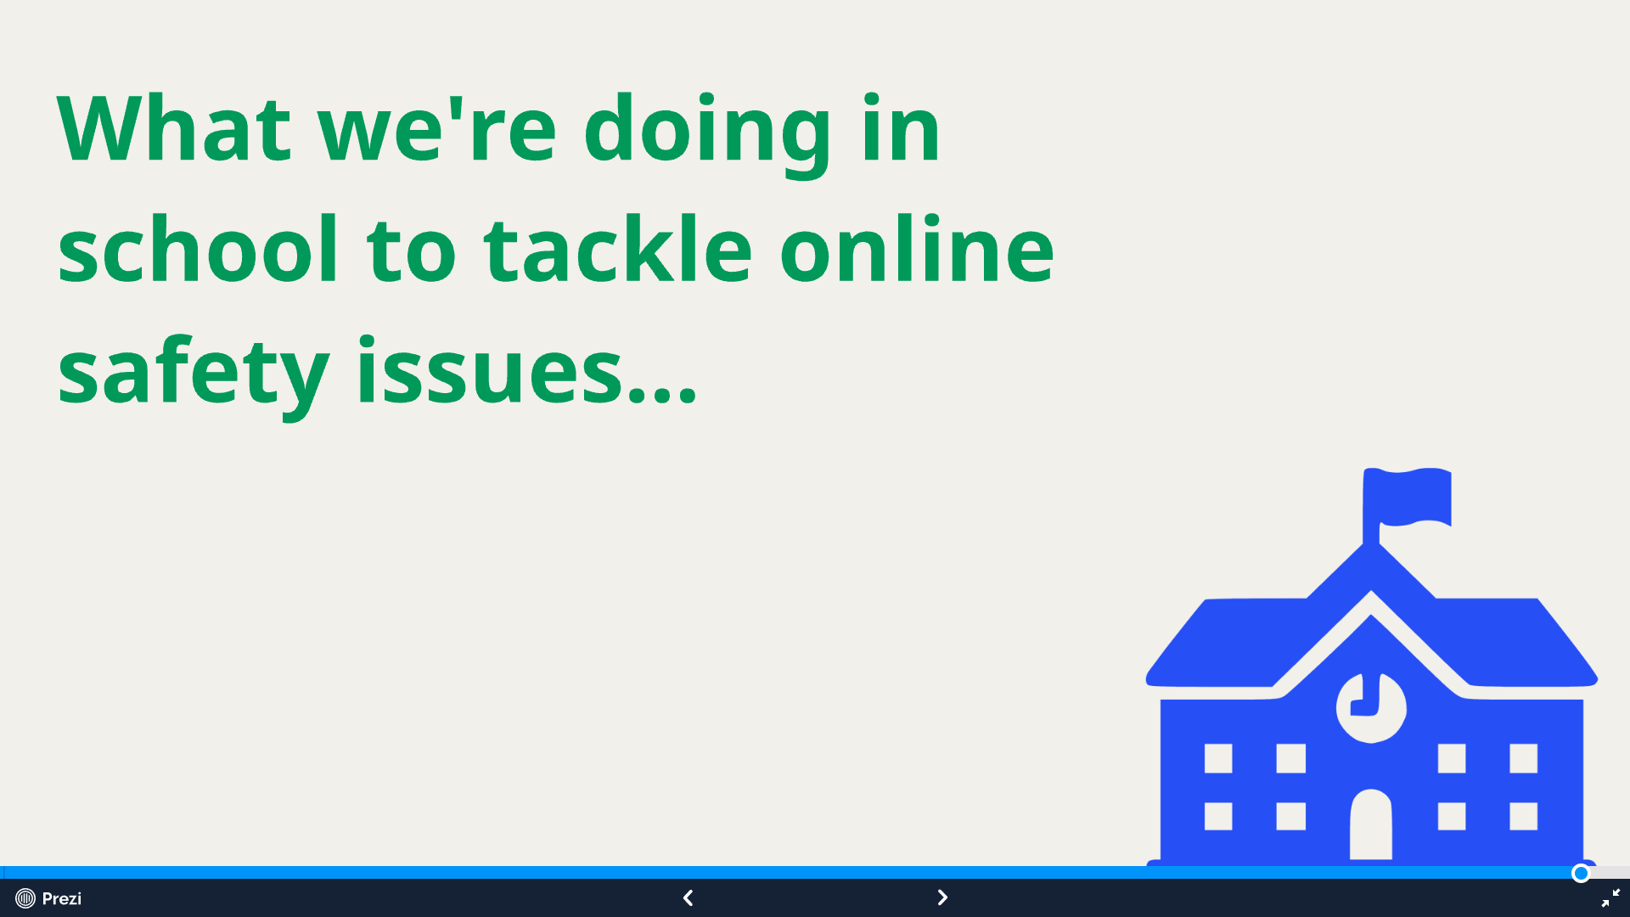

Slide 67
The DSAMAT is committed to ensuring all schools are cyber safe and work with ‘Partnership Education’ who have carried out cyber security audits in all schools.
Home - Partnership Education
Partnership Education supports schools to provide filtering and security services and device monitoring to ensure that our schools meets with Keeping Children Safe in Education guidelines.
Keeping Children Safe in Education 2024 states:
“It is essential that children are safeguarded from potentially harmful and inappropriate online material. An effective whole school and college approach to online safety empowers a school or college to protect and educate pupils, students, and staff in their use of technology and establishes mechanisms to identify, intervene in, and escalate any concerns where appropriate.” p. 35.
All staff are trained in E safety and Cyber Security and filtering and monitoring procedures in school.

Slide 68
Schemes we use:
https://www.gov.uk/government/publications/education-for-a-connected-world
https://jigsawpshe.online/
https://projectevolve.co.uk/
Purple Mash and Online Safety - 2simple.com
Teach Computing

Slide 69









More resources we use..
https://www.booksfortopics.com/booklists/topics/science-maths-computing/internet-safety/
https://www.childnet.com/resources/digiduck-stories/

Slide 70
What is the Government doing?
Online Safety Act: explainer - GOV.UK

